Slide 1


Putting the View of MVC into a Spring Bean with htmx
JUG Stuttgart – 2024.02.29
Thomas Schühly
Notes:
Hello and welcome to my talk, Putting the View of MVC into a Spring Bean with htmx.

Slide 2

Thomas Schühly
Spring Boot + Kotlin + HTMX = ❤️
Blogging @tschuehly.de
Open-Source Developer:
github.com/tschuehly/spring-view-component
github.com/tschuehly/htmx-supabase-spring-boot-starter
Youngest Speaker @Spring I/O
Software Engineer @alanda
Notes:
My name is Thomas Schühly, I’m 23 years old and I’m passionate about building awesome software with Spring.
I’m blogging about my experiences at tschuehly.de.
I’m the developer of two open-source Libraries. Spring ViewComponent and the htmx supabase spring boot starter.
I was fortunate last year to talk about them at Spring I/O 2023 making me the youngest speaker ever there.
I have the privilege to work full time with Spring ViewComponent as I joined alanda last year which has embraced it for their enterprise product.

Slide 3
Software Engineering
Notes:
I assume most of you are Software Engineers, all of you know what Software part is

Slide 4
Software Engineering
Notes:
But have you thought about the Engineering part? What is Engineering and how should it affect us when developing and designing modern software applications?

Slide 5



Notes:
I am drawing upon the insights of Dave Farley, an expert in Continuous Delivery.
He co-authored the pioneering book “Continuous Delivery” establishing a practice which has become industry standard.

Slide 6
Engineering
„Stifling Bureaucracy and heavy weight process control“
„Simply writing code and nothing else“
Dave Farley
What is Modern Software Engineering?
Notes:
He shares his point of view about Engineering in his blogpost “What is Modern Software Engineering”
He is uneasy with the term “engineering” in the context of Software Development, as it was either incorrectly loaded with meaning or emptied of it all together.
Some developers believe that "engineering" entails oppressive bureaucracy and excessive process control, while others believe that "engineering" only involves writing code and nothing beyond that."

Slide 7
“In other disciplines, Engineering is simply the stuff that works. It is practical, pragmatic and more, not less, efficient.”
Dave Farley
What is Modern Software Engineering?
Notes:
He tells us that both of these are profoundly wrong. In other disciplines, “Engineering” is simply the stuff that works.
It is practical, pragmatic and more, not less, efficient.”
But the question I want to discuss today: Is the way we build modern web applications “practical, pragmatic and efficient?”
Could there not be a simpler approach that is sufficient for many use cases?

Slide 8
“if an engineering approach to software development doesn’t help us to create better software faster, then it’s wrong and doesn’t qualify as “Engineering”. ”
Dave Farley
What is Modern Software Engineering?
Notes:
Farley concludes that, if an engineering approach to software development doesn’t help us to create better software faster, then it’s wrong and doesn’t qualify as “Engineering”.

Slide 9



Notes:
Did we overshoot this goal?
Modern JavaScript frameworks are more complex than ever before to solve the problems that they themselves created.
What if instead we took a step back and tried to reduce the complexity of our modern web applications that is not inherent in the challenges of our business domain, but accidental due to the nature of our solutions.

Slide 10
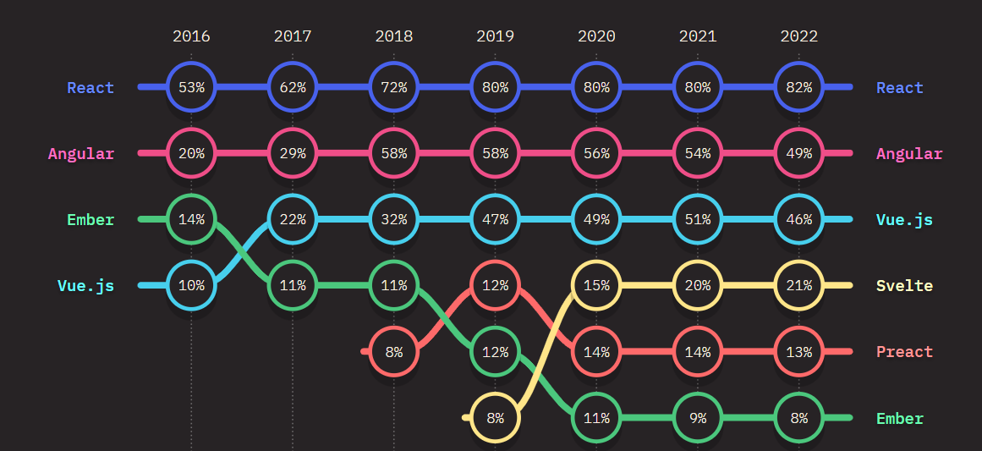
FRONT-END FRAMEWORK USAGE OVER TIME
State of JavaScript Survey 2022
Notes:
Modern JavaScript Frameworks were developed to manage the complexity of front-end web development and to improve the User and Developer Experience.
They are mostly Single Page Application Frameworks, meaning a Blank HTML Page with a big blob of JavaScript is delivered, which then takes over the Render Process.
React has grown over the last decade to the dominant JavaScript Framework. 82 percent of Developers in the State of JavaScript Survey used it.

Slide 11
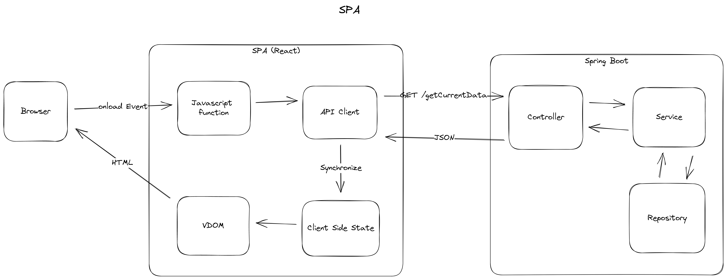
Single Page Application
Notes:
What you see here is the typical render path of a Single Page Web Application that is displaying data from our Spring Boot Backend.
The Browser calls a JavaScript function, this function then calls an API Client to create an http request to the backend.
The backend fetches the data from the database and transforms it into a POJO, then Jackson transforms the objects into a JSON representation.
The JavaScript API client then parses the JSON Data back into a JavaScript object.
This object is then synchronized with the current client-side state.
The SPA then merges the changes into the Virtual Dom and then that Virtual DOM is synchronized with the HTML Browser DOM.

Slide 12
After years of relative stability, many are now beginning to question the status quo. [..] on the server Astro, Remix and Next.js (among others) are making us reconsider how much code we really need to ship to the client.”
State of JS 2022
https://2022.stateofjs.com/
Notes:
The JavaScript community themselves started to question this way.
The Introduction to the State of JS Survey 2022 reads:
[ZITAT]

Slide 13

Do we need the complexity of “modern” JavaScript frameworks for building web?
Notes:
But if even JavaScript Developers are questioning how much JavaScript they ship to the client, why do we Java developers need all that complexity of the JavaScript frameworks?
Do we really need a full client-side rendered Single Page Application to enable interactivity in our web applications?

Slide 14
Single Page Applications are an architectural style, that incurs additional complexity.
Tradeoffs review is skipped, if requirements need a framework like React
thoughtworks Technology Radar Vol. 27
www.thoughtworks.com/content/dam/thoughtworks/documents/radar/2022/10/tr_technology_radar_vol_27_en.pdf
Notes:
The engineers contributing to the thoughtworks technology Radar 2022 agree.
It reads: Single Page Applications are an architectural style, that your team should choose after a proper analysis of the tradeoffs involved like the additional complexity a SPA incurs.
Too often this trade-off review is skipped, and it is not evaluated if the business or user experience requirements need a framework like React.
Many developers are not even aware of the possibility of another way of doing things because they spent their entire career, in a framework like React.

Slide 15
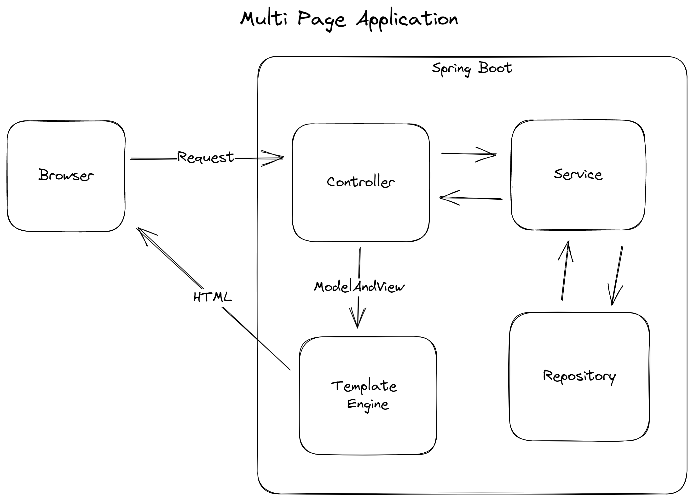
Notes:
Most of you are probably familiar with the traditional approach to the web, Multi Page Applications.
They power most of the web today in the form of WordPress.
Instead of shipping a giant JavaScript bundle to render the page on the client, we just ship HTML directly rendered on our server to the browser.
When the browser creates a Request to a Controller Endpoint, we retrieve the data from our database and we pass the data as model and the HTML Template as view to a template engine that renders the view and model to html and sends it back to the browser.

Slide 16
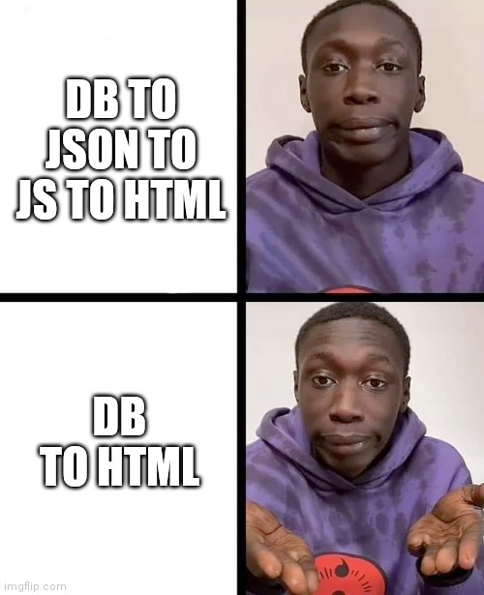
Notes:
Sounds awesome right? We removed a whole lot of complexity, because we removed two data representation layers between the client and our data.
But we lost the interactivity of JavaScript, as we currently send static HTML without any client-side JavaScript to our user.
How can we add interactivity to our Server Rendered HTML?

Slide 17
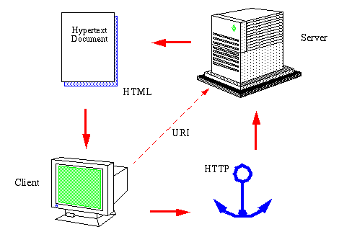
Notes:
To solve this challenge, we need to focus back on the original model of the giant hypermedia system we know as world wide web and focus on the technology that made it first possible.
The Hypertext Markup Language delivered directly on the Hypertext Transfer Protocol.

Slide 18
Hypermedia is defined by the presence of application control information embedded within, or as a layer above, the presentation of information.
Roy Fielding
Architectural Styles and the Design of Network-based Software Architectures
Notes:
Roy Fielding described Hypermedia in his dissertation:
“Hypermedia is defined by the presence of application control information embedded within, or as a layer above, the presentation of information.”.
In plain terms when we deliver Hypermedia to the client, we deliver how the application looks and how to interact with the application.

Slide 19
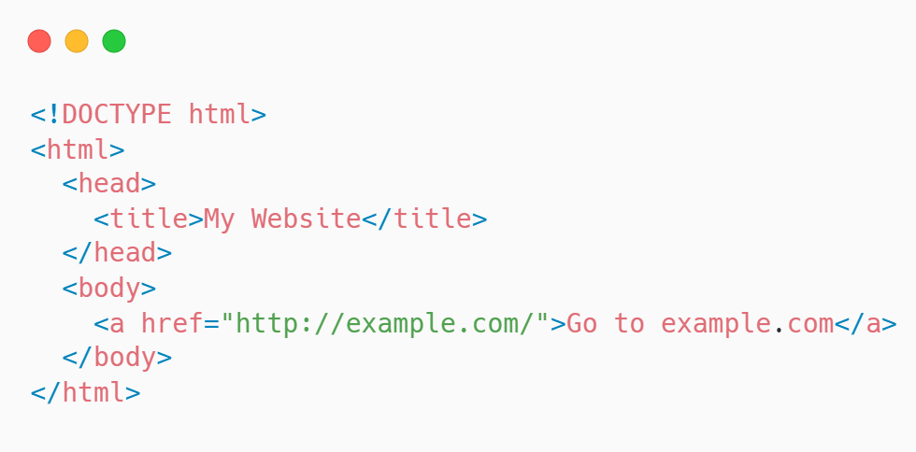
Notes:
Hypertext is text that defines references to other text resources. These references are called hyperlinks and you probably know them in the form of anchor tags.

Slide 20
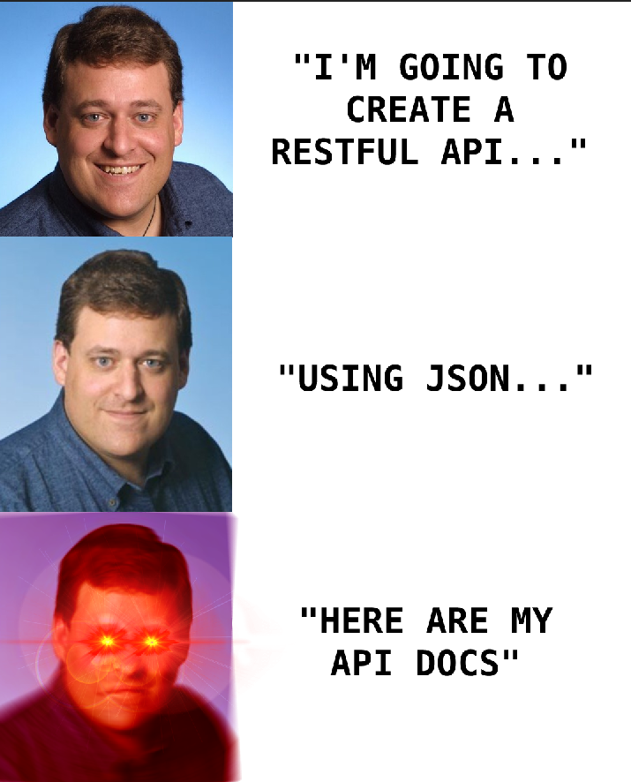
https://roy.gbiv.com/untangled/2008/rest-apis-must-be-hypertext-driven
Notes:
A common misconception about building a RESTful API is that it is only about using URIs for resources and HTTP verbs correctly, but Fielding made it clear that the Engine of Application State of a REST API must be driven by HyperText.
This principle is called HATEOAS and is not a common occurrence when developing a web application with a JavaScript frontend framework.

Slide 21

Notes:
With HATEOAS, the client interacts via the server provided information dynamically through hypermedia.
It decouples client and server at the network level, enabling the server to evolve independently from the client, as the server provides both the data and how to act on the data.
To leverage the principles of REST, we would need to implement our own Hypermedia Client in an Single Page Application frontend.
But what if instead of offering a JSON API to render the templates on the client we will send fully server-rendered HTML with interactivity to our client.
This makes it a full REST API with HATEOAS.

Slide 22
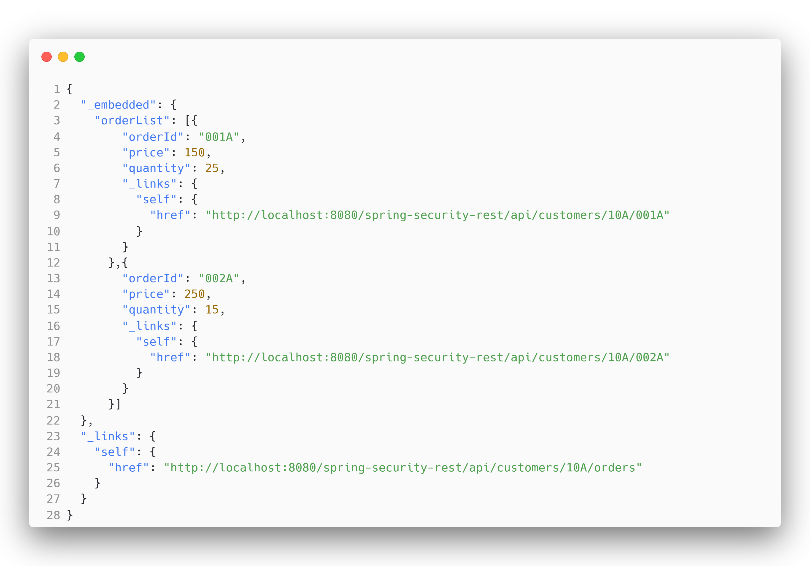
Notes:
You might have heard of the Spring HATEOAS project, which commonly uses a form of JSON Hypermedia representation.
This is great for API discoverability, but it doesn’t really decouple the frontend from our backend in a web browser-based application, as we split the presentation information and the application controls.

Slide 23
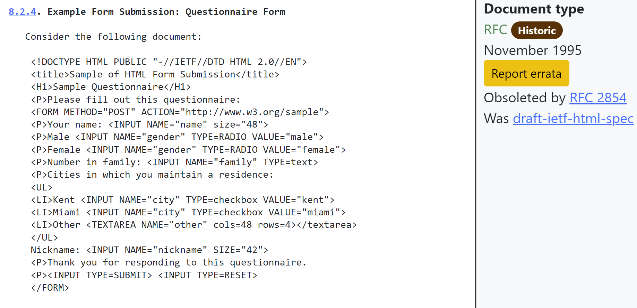
Notes:
So why did we move away from the Hypermedia model to the JavaScript Dystopia of today?
We did because HTML is quite limited and did not really evolve as a Hypermedia.
If you think about it, there are only two hypermedia controls, the anchor tag enabled the fundamental hypermedia system we know as the world wide web, by allowing to interconnect resources with URIs.
The second element was the form tag, introduced in the HTML 2 RFC in 1995. It enabled transactions for this vast hypermedia system for the first time.
It made web experiences as we know them today possible. But as you can see the form element looks the same as it did 28 years ago.

Slide 24
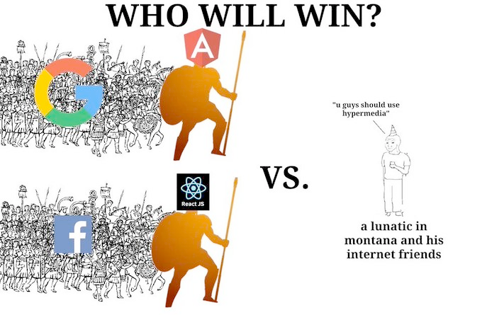
Notes:
But one guy in Montana and his friends were not satisfied with the state of HTML and started a Library to complete HTML as a Hypermedia.
They’re competing against the giant JavaScript Ecosystem fuelled by big tech as we know it today.

Slide 25

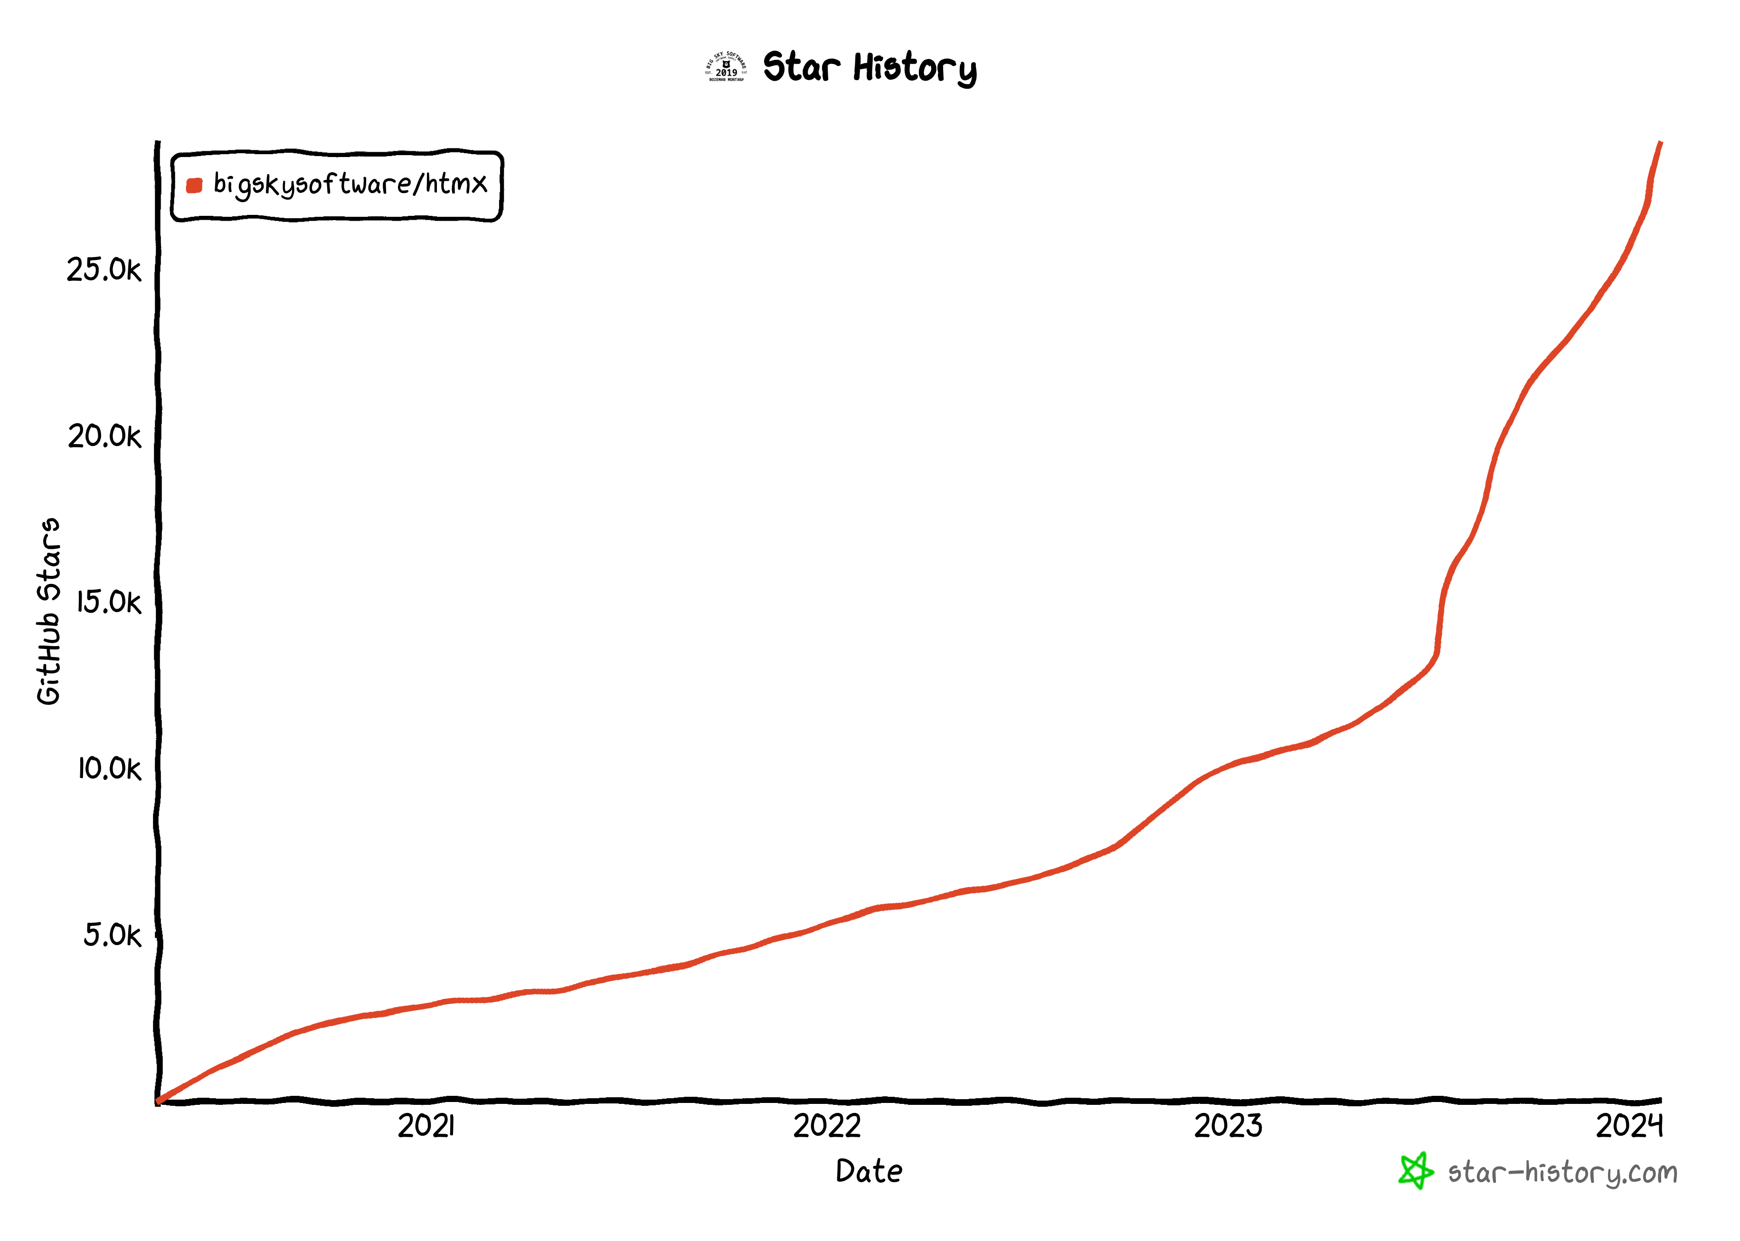
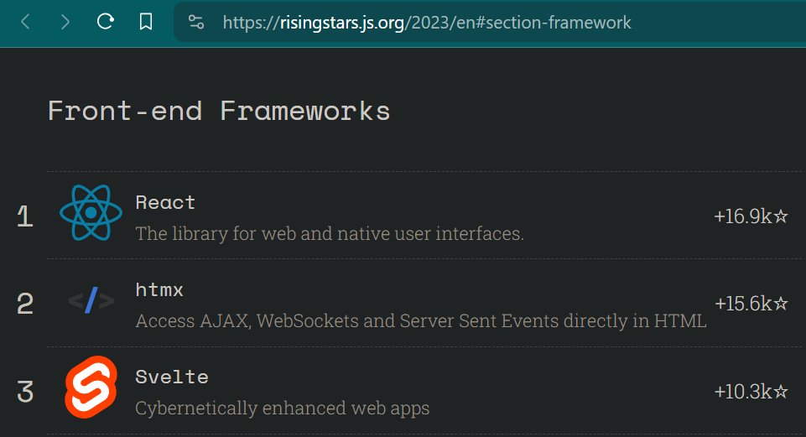
Notes:
This Library is called htmx and it is gaining popularity over the last 2 years.
It recently got picked for the first GitHub open-source accelerator program.
In a Nutshell htmx allows you to access modern browser features without ever leaving your HTML.
You can create interactive features without needing to touch JavaScript.

Slide 26
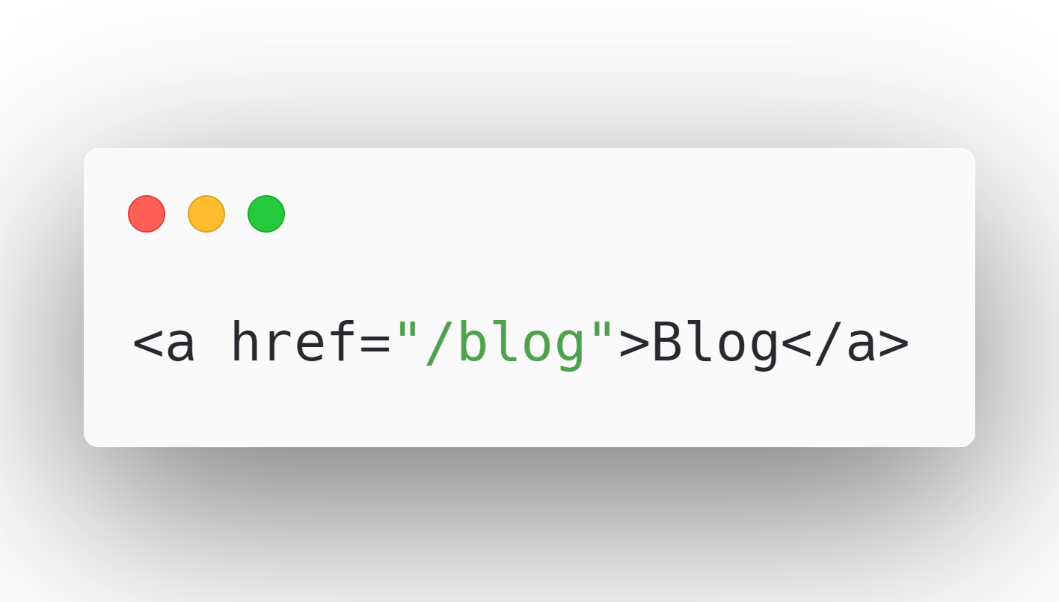
Notes:
To understand htmx we will first take a look at the native anchor tag:
This anchor tag tells a browser:
“When a user clicks on this link, issue an HTTP GET request to ‘/blog’ and load the response content into the browser window”.

Slide 27
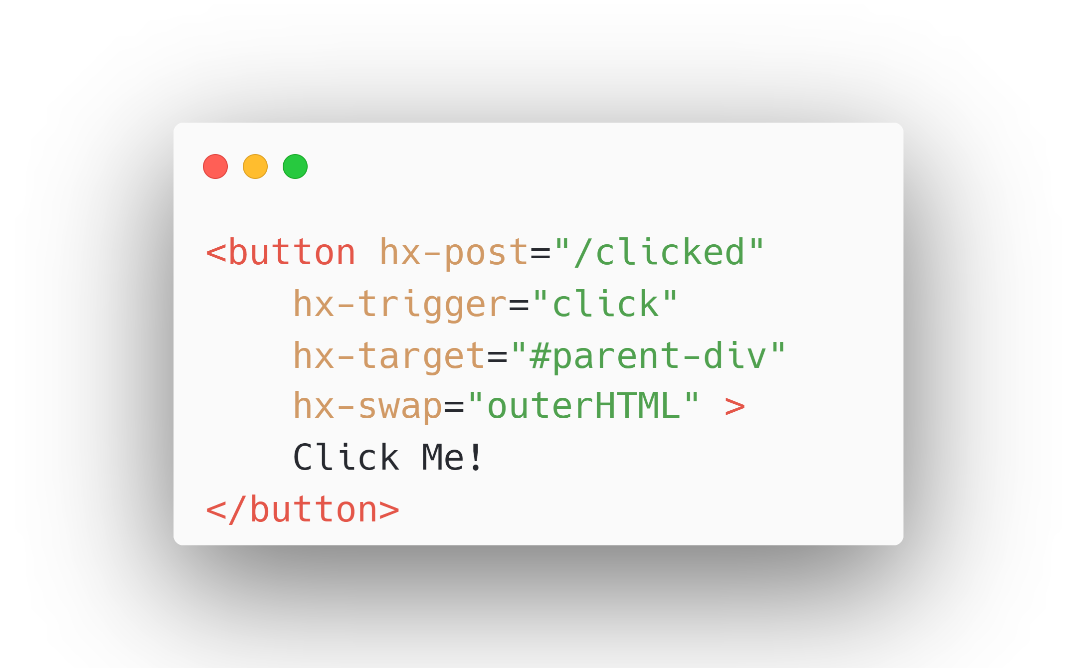
Notes:
If we now look at a simple example of HTMX:
This button element tells htmx:
“When the user clicks on this element, issue an HTTP POST request to ‘/clicked’.
Use the content from the response to replace the element with the id parent-div in the DOM, and swap the whole element.”
HTMX has sensible defaults, you wouldn’t need the hx-trigger attribute because it is the standard behaviour for a button element.
htmx extends and generalizes the core idea of HTML as a hypertext, opening up many more possibilities directly within the language.

Slide 28
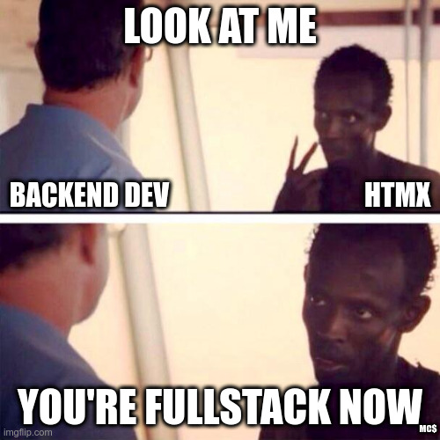
Notes:
HTMX enables backend developers to create full-stack applications without leaving the JVM.
Now any element, not just anchors and forms, can issue an HTTP request
Now any event, not just clicks or form submissions, can trigger requests.
Now any element, not just the entire window, can be updated by the HTTP response.

Slide 29
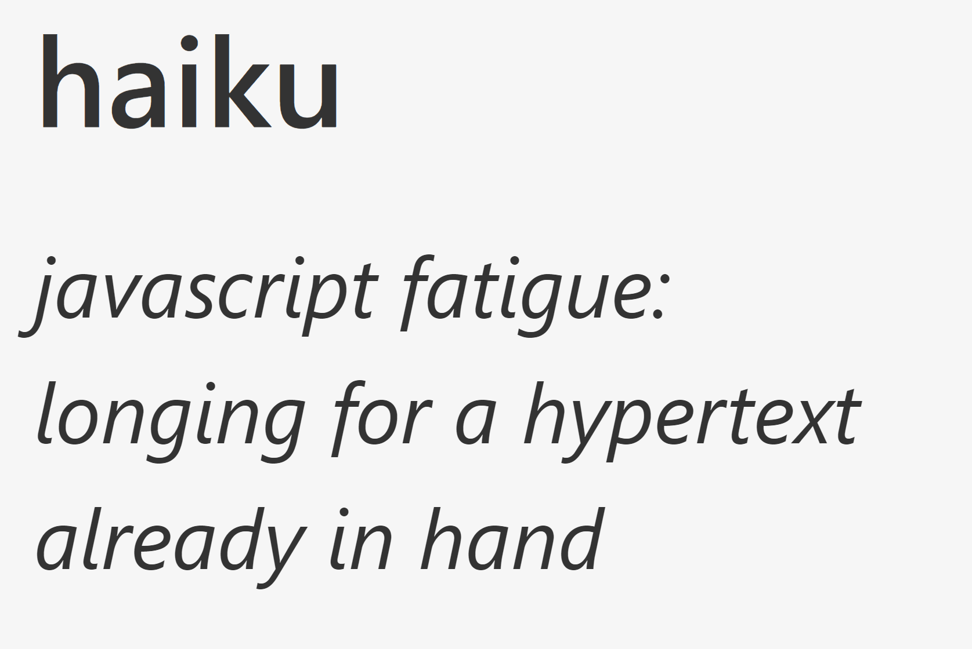
Notes:
HTMX refers to this style of application as a Hypermedia Driven Application or short HDA.
It tries to capture the advantages of both: the simplicity and flexibility of a Multi-Page Application with a RESTful architecture that uses Hypermedia as the Engine of Application State, with the better user experience of a Single Page Application.

Slide 30
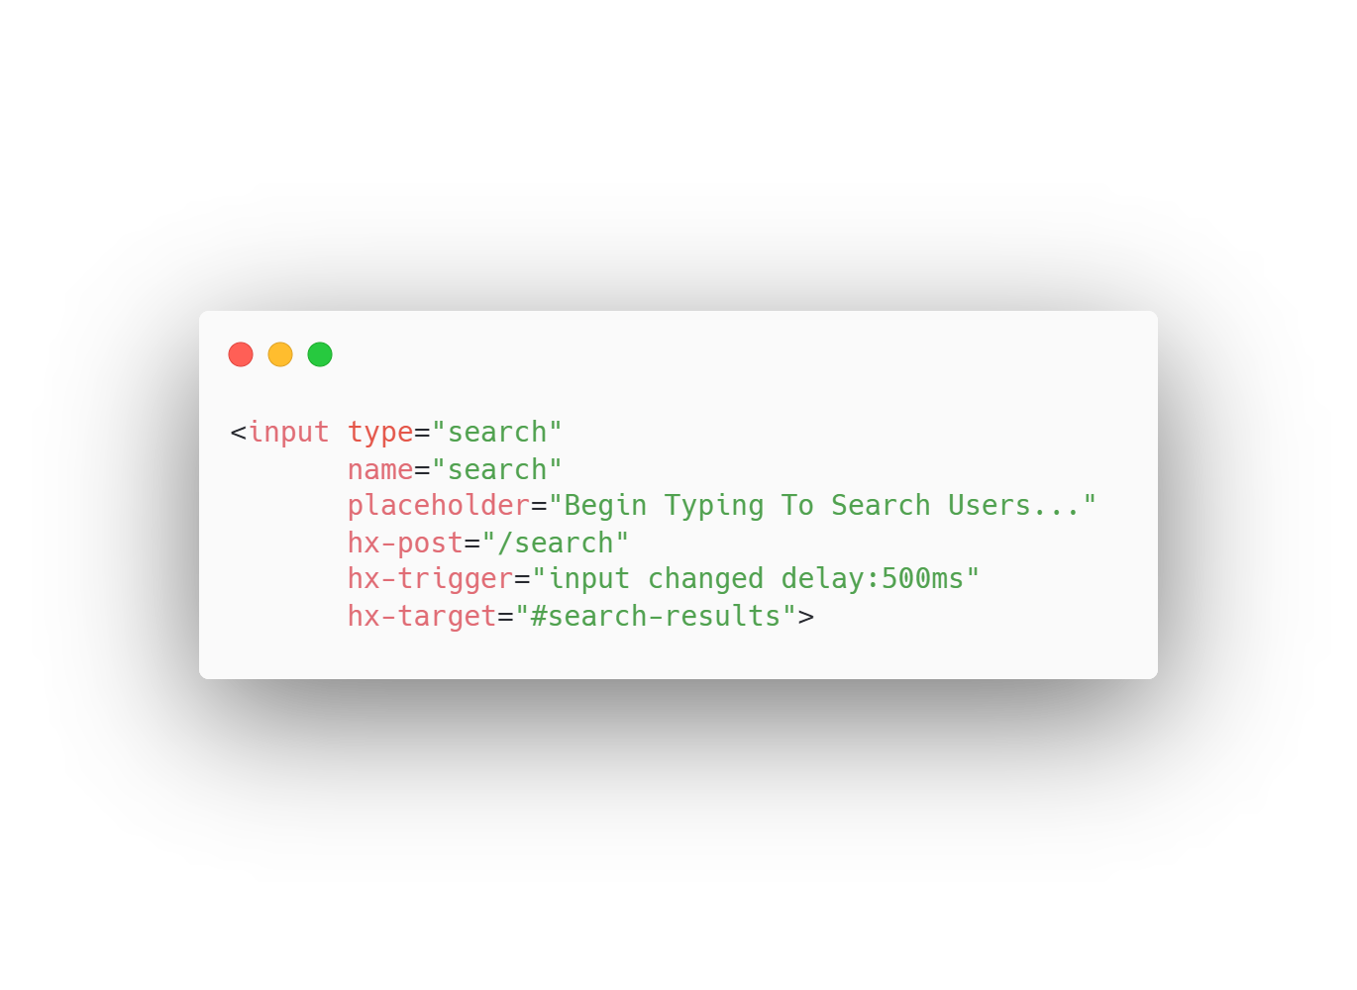
Notes:
This gives us the possibility to create UX Patterns that would typically be associated with an SPA, like Active Search.
This input field triggers a post request to the /search endpoint on every keyup, debounced by 500ms. Then the HTML Response is swapped with the search-results element.

Slide 31
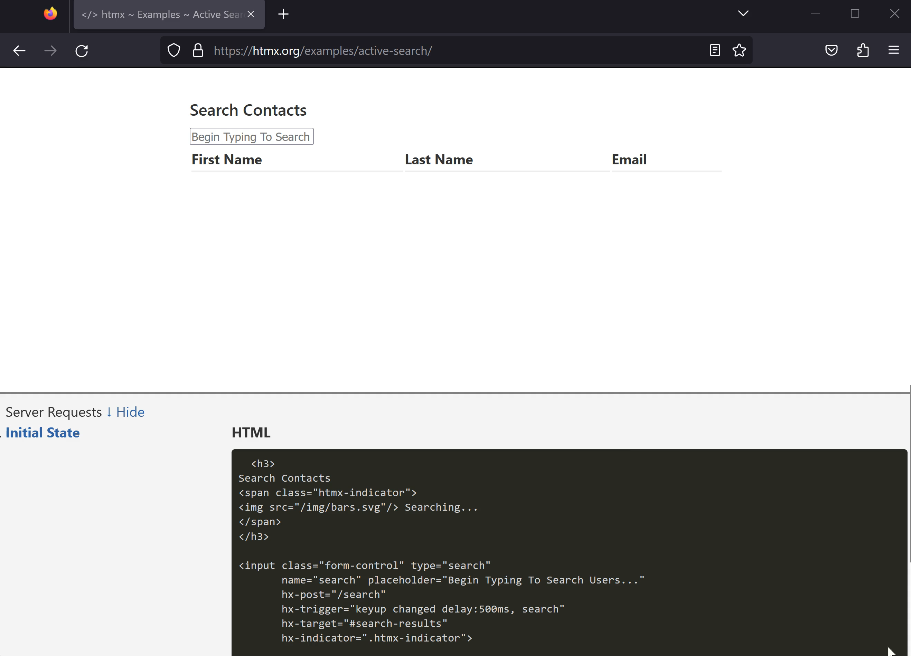
Notes:
Here you can see the active search example on htmx.org. It offers the same experience that you get with a Single Page Application but with a fraction of the complexity.
->
This example shows the essential characteristics of an HDA, the frontend of the feature is entirely specified in declarative htmx attributes inside the html and the interaction with the Server is done via HTTP and HTML, htmx makes the request for us and swaps the HTML into the DOM.
It would not be a farfetched idea to think that If HTML would have evolved further as a Hypermedia that these features could be native HTML enabled by the browser.

Slide 32
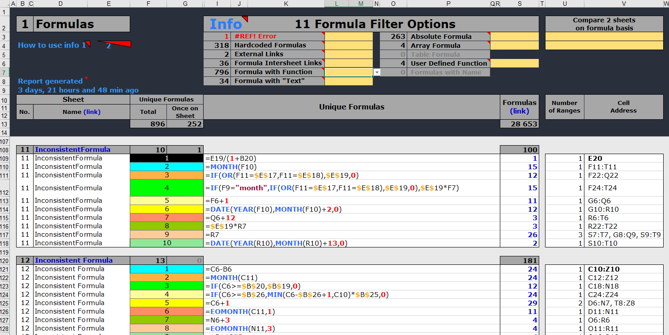
Notes:
Every approach has advantages and disadvantages that should be considered when engineering software. Hypermedia driven Applications are no exception.
If the UI has many, dynamic interdependencies like a spreadsheet, that cannot be determined at server-side render time, a Hypermedia Driven Application is not suitable for that.

Slide 33
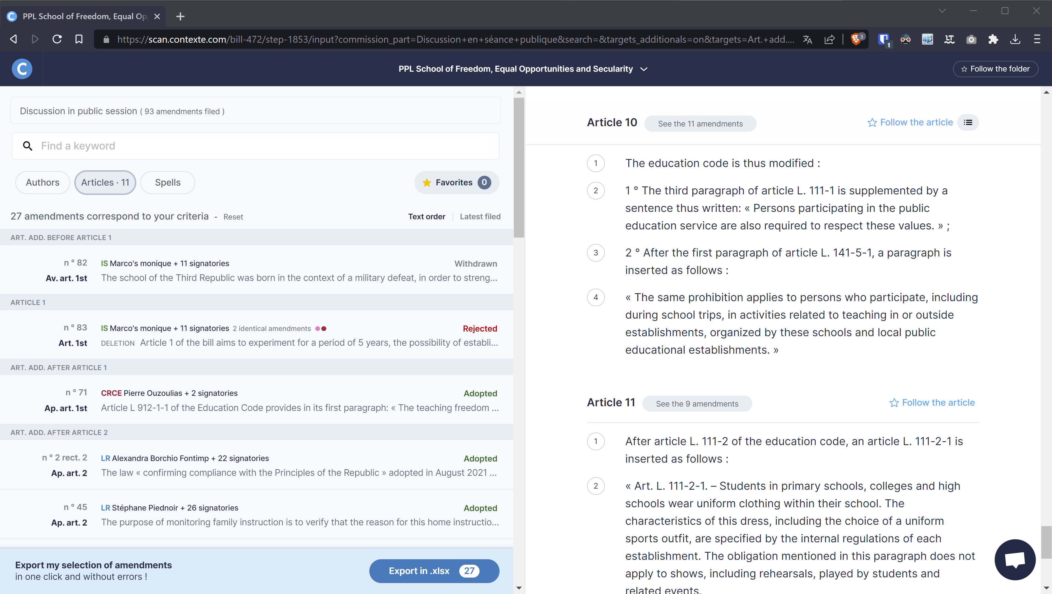
Notes:
Next, we will look at a real-world example from the SaaS business Contexte which has transitioned their production django application from React to HTMX.
They track legislation in the French senate and show amendments and make them searchable and filterable, all with the power of HTMX.

Slide 34
Notes:
They have a good use case for htmx, as the UI is nested and the blocks that need to be updated are well defined.
It is easy to enable dynamic interaction by just swapping these areas.
This lends itself especially to server-side UI components as we can just re-render these components on demand.
As you can see their UI is mostly text, they have sophisticated filtering, but the crux of the application is displaying and categorizing articles

Slide 35
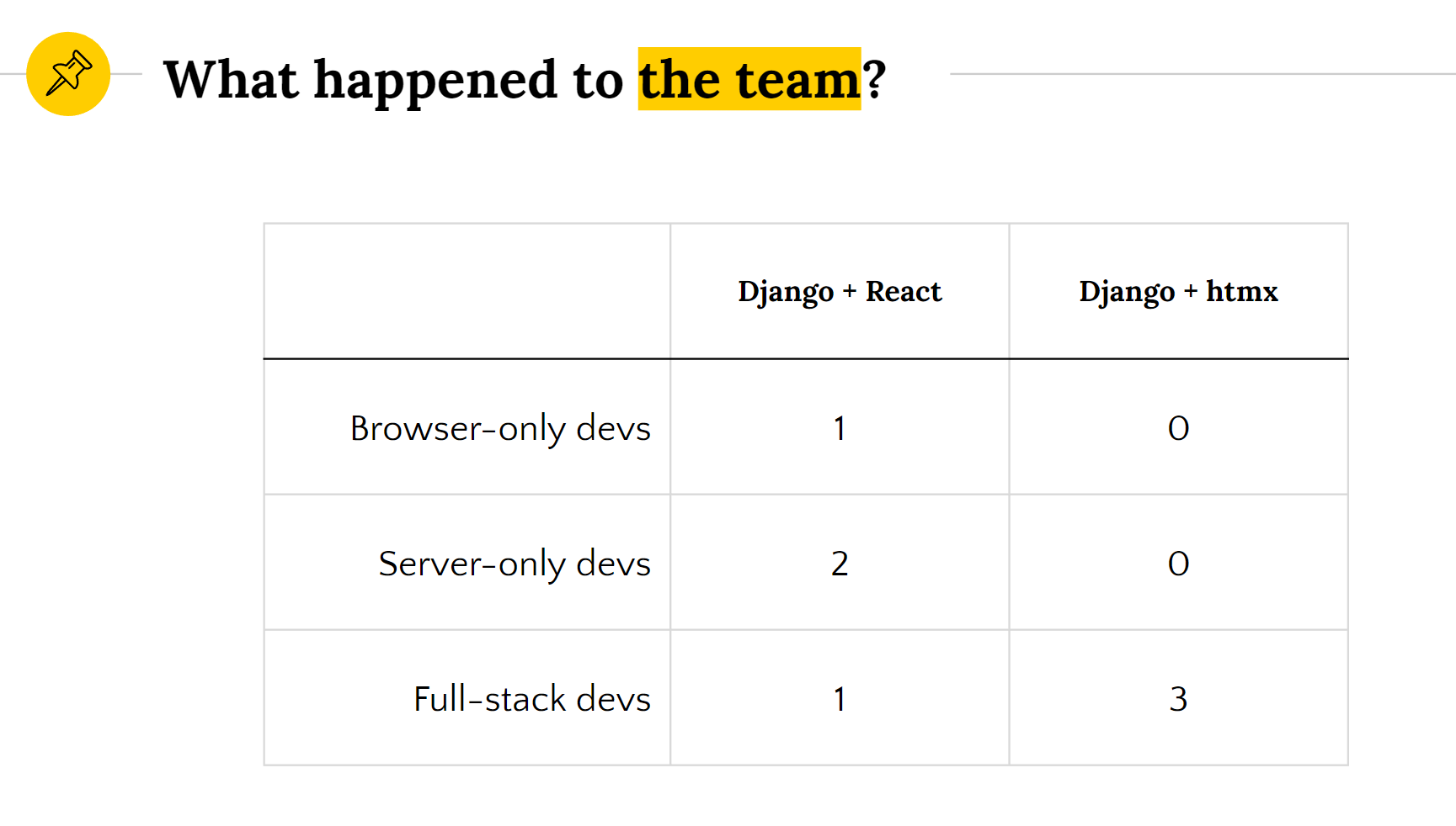
SaaS Startup „Contexte“
Notes:
By using htmx and radically simplifying the web development approach, the team structure simplifies as well.
When Contexte was using react, there was a hard split between back-end and front-end, with two developers being entirely back-end, one developer being entirely front-end, and one developer being “full stack”.
After the port to HTMX, the entire team became “full stack” developers. Except the JavaScript Developer, he apparently didn’t make it.
Each team member is more effective and able to contribute more value.
Hypermedia makes development more fun since developers can own an entire feature.
It leads to better optimized software, since the developer can make optimizations anywhere in the stack without needing to coordinate with other developers.

Slide 36

Notes:
But how do we fill the HTML with the data from our database and deliver it to the User in Spring applications?

Slide 37

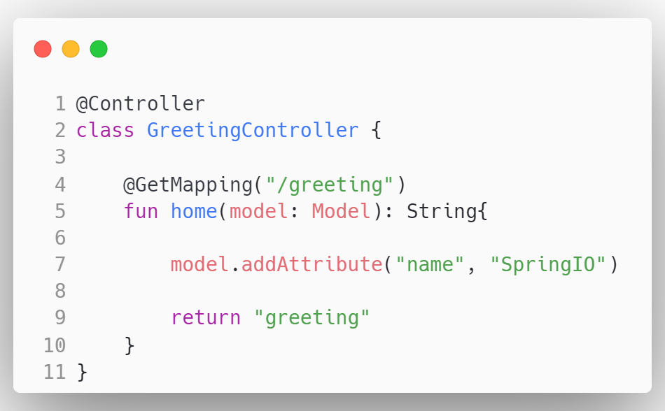
Notes:
We use server-side rendering with a template engine!
Spring uses the Model View Controller Pattern.

Slide 38
Notes:
With MVC the browser sends a request to a Controller, where we have a GetMapping to the path “/greeting”,

Slide 39
Notes:
Then the Controller manipulates the model, here we add a name attribute.

Slide 40
Notes:
And finally we return the name of the template we want to render. In this case the greeting.html template in the resources folder

Slide 41
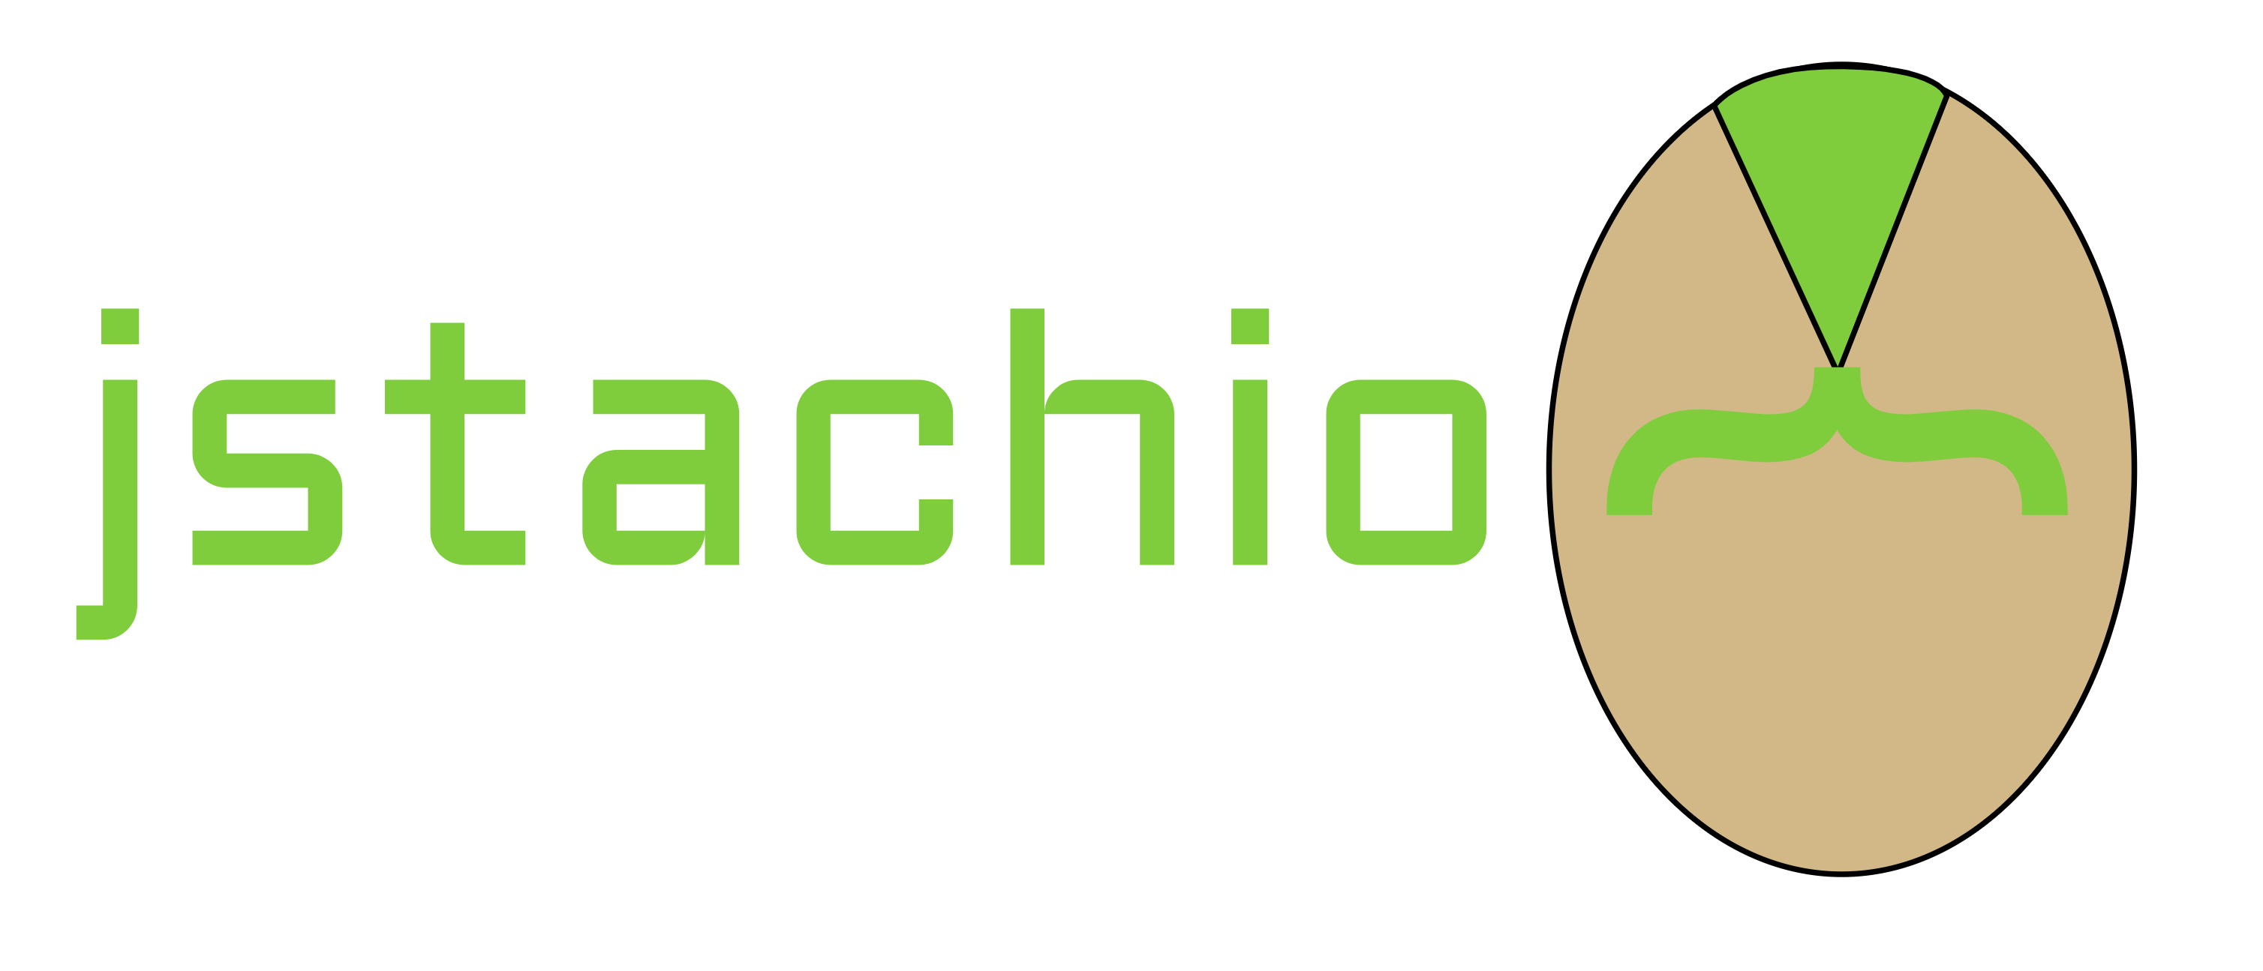
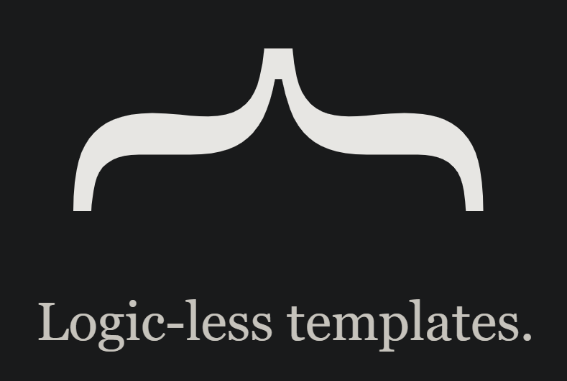



Notes:
There are multiple template engines for spring to render html with dynamic content like Apache Freemarker, JMustache or jstachio but in this talk we will take a look at Thymeleaf and JTE, the Java Template Engine.

Slide 42
Notes:
First, let’s take a look at Thymeleaf.

Slide 43
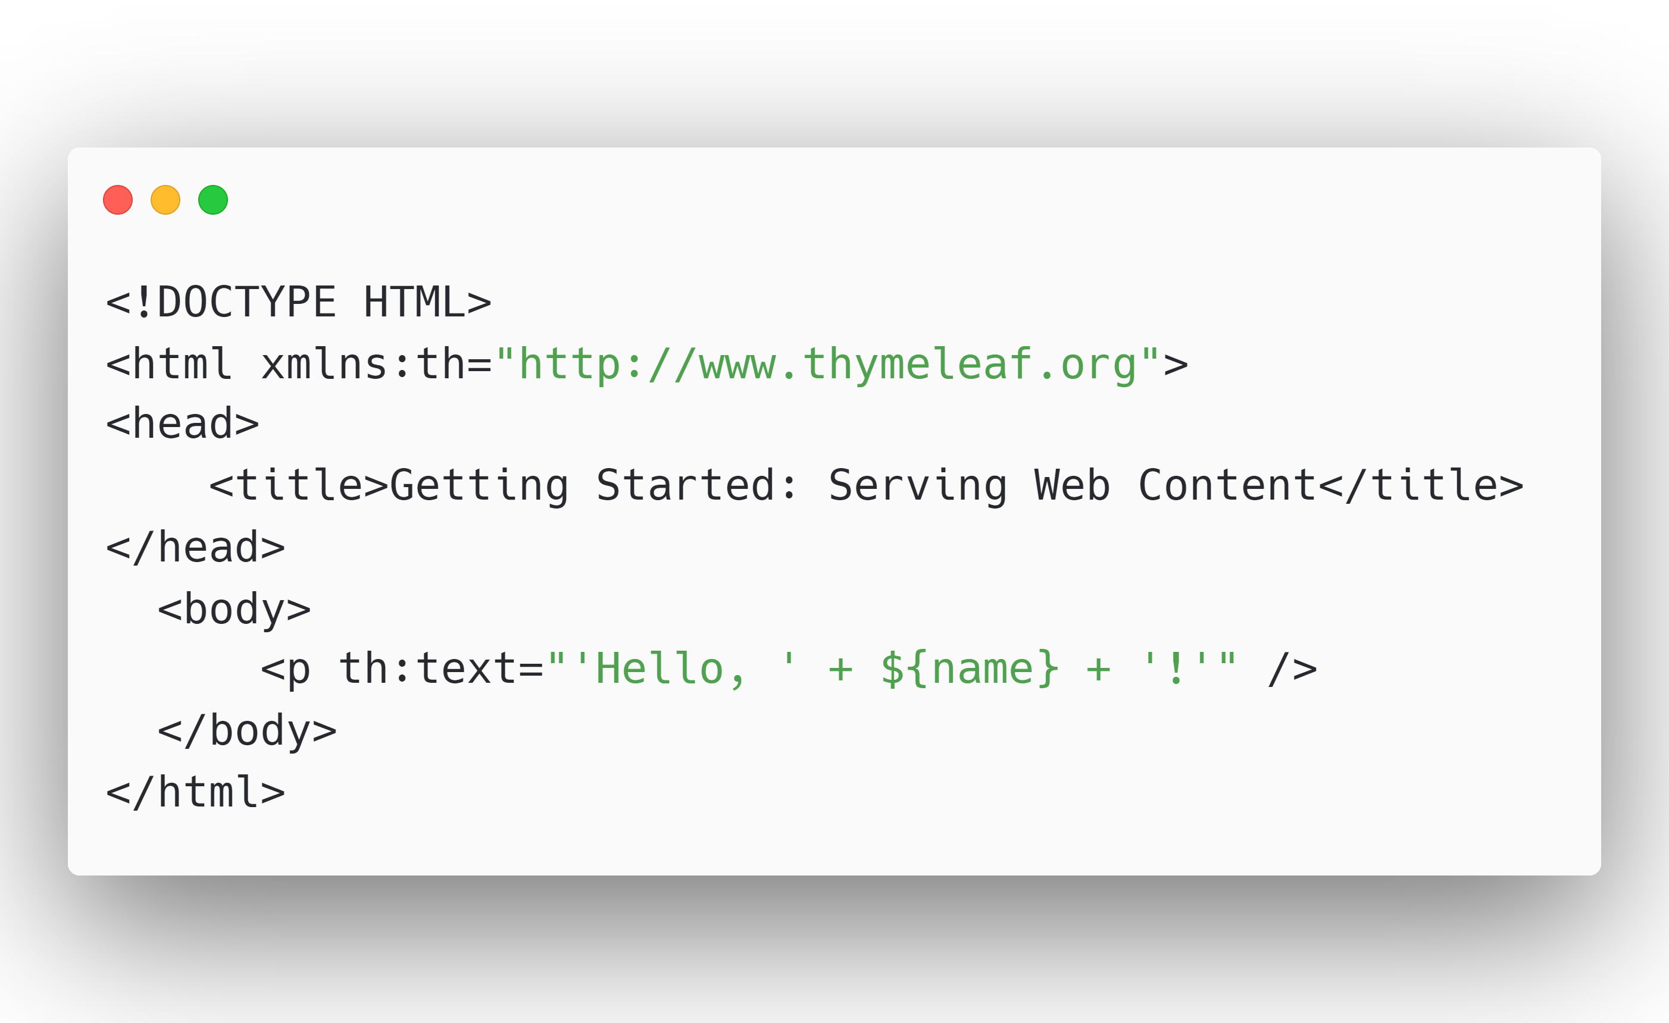
Notes:
It is simple to return rendered HTML from our Endpoints.
We’ll start with the greeting.html Template we just returned from our Controller. It is bog standard HTML,

Slide 44
Notes:
To render the data we can define th colon attributes. In this case we define a th:text attribute.
This adds “hello” and the value of the model attribute “name” to the innerHTML of our p tag.

Slide 45
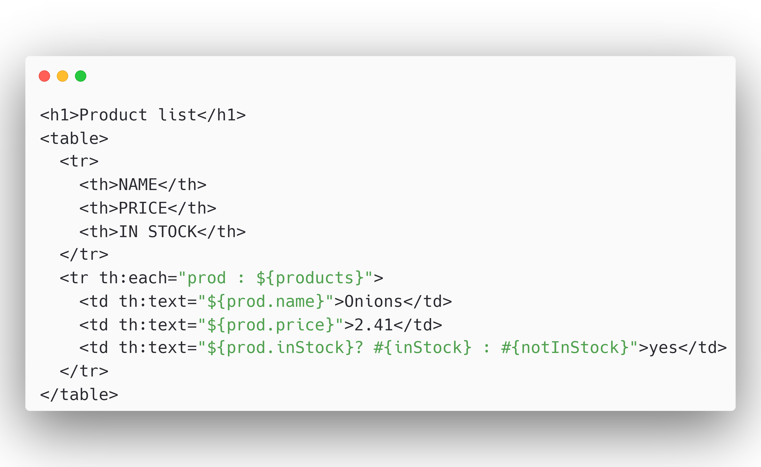
Notes:
We can also iterate over collections with the th:each tag. We can then access the properties of each object in our collection. In this example we show a table data cell for each property of our product object.

Slide 46
Notes:
Conditionals are also very simple. We use the ternary operator you might now from other languages.
If the inStock boolean evaluates to true we will show the message inStock and else we show the message notInStock
Thymeleaf has a lot more features, but I will not go more in depth, as you can build so much with these two already.

Slide 47
Notes:
Next, we will look at the Java Template Engine, which might feel more natural for Java Developers and has an awesome IntelliJ Plugin that makes JTE very productive.

Slide 48
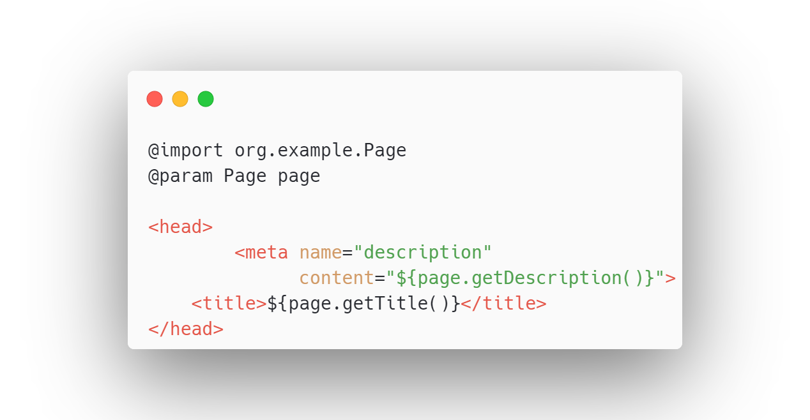
Notes:
Because JTE Templates are compiled to native Java classes, you need to import necessary Classes with the @import syntax, you also declare the parameters that need to exist in the model right on the template with an @param annotation.

Slide 49
Notes:
With JTE we can use plain java expressions right inside the html, inside some curly braces. You can use them wherever you want, inside attributes or between html tags.

Slide 50
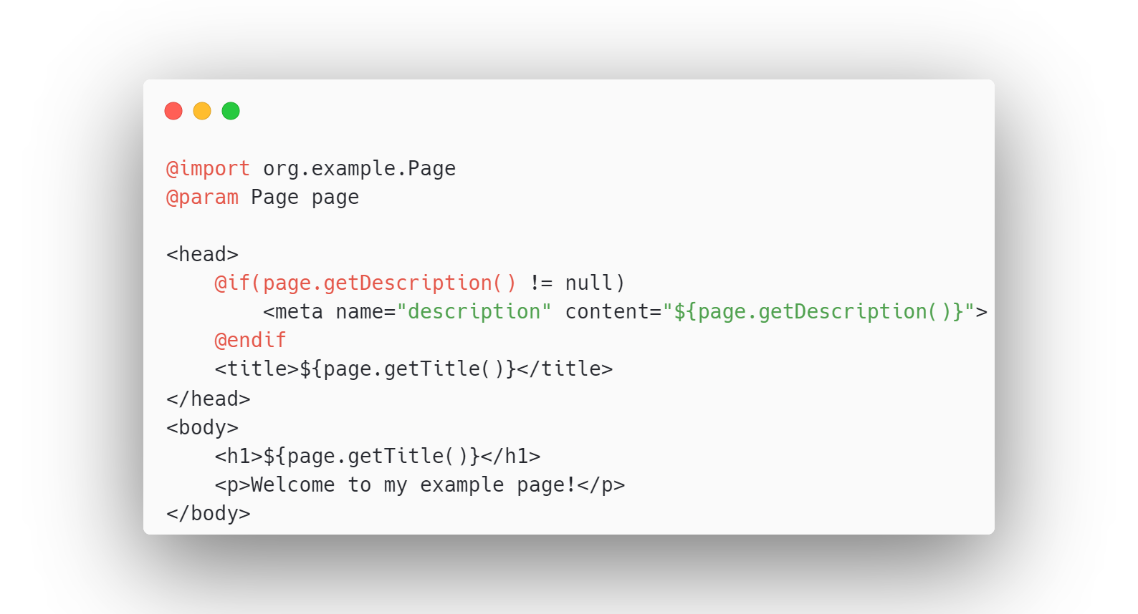
Notes:
You can also use control structures like ifs that feel like java right in your HTML. Here we check that the description is not null.

Slide 51
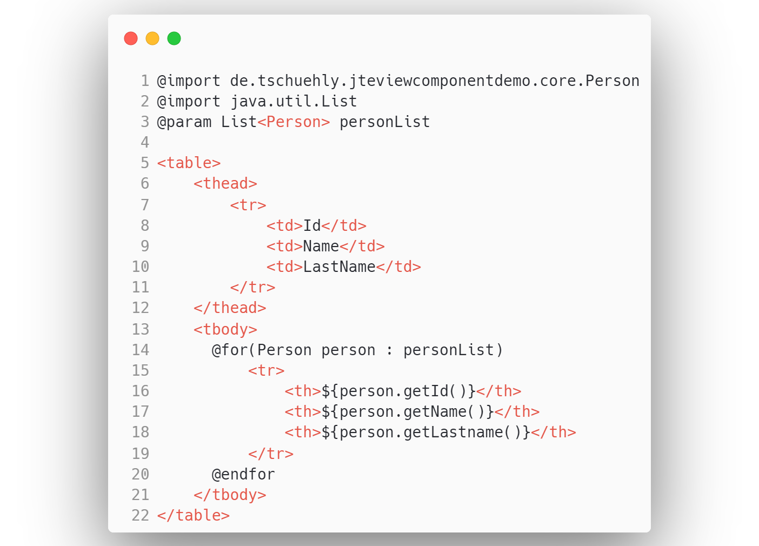
personlist.jte
Notes:
We can also you use for loops, for example to loop over a List of Objects to create a Table.
In this example we have a list of persons and we want to show each person as a row of our table.

Slide 52
Notes:
The Model View Controller Approach is simple, but it has shortcomings, that I’ve experienced over the last few years.
The two most popular JavaScript SPA Frameworks are built by some of the smartest Software Engineers in the world at Google and Facebook.
There is a reason that they build UIs based on components. Because components make the UI reusable and self-contained.

Slide 53


Notes:
And components are pretty cool, that’s why GitHub built their own ViewComponent library for their monolith server rendered ruby on rails web application: github.com.
The documentation tell us the main benefit:
“ViewComponents consolidate the logic needed for a template into a single class, resulting in a cohesive object that is easy to understand.”

Slide 54

github.com/tschuehly/spring-view-component
Notes:
I’ve started the Spring ViewComponent library to get the same benefits in server-render Spring Application and solve the issues that are present while using Spring MVC.

Slide 55
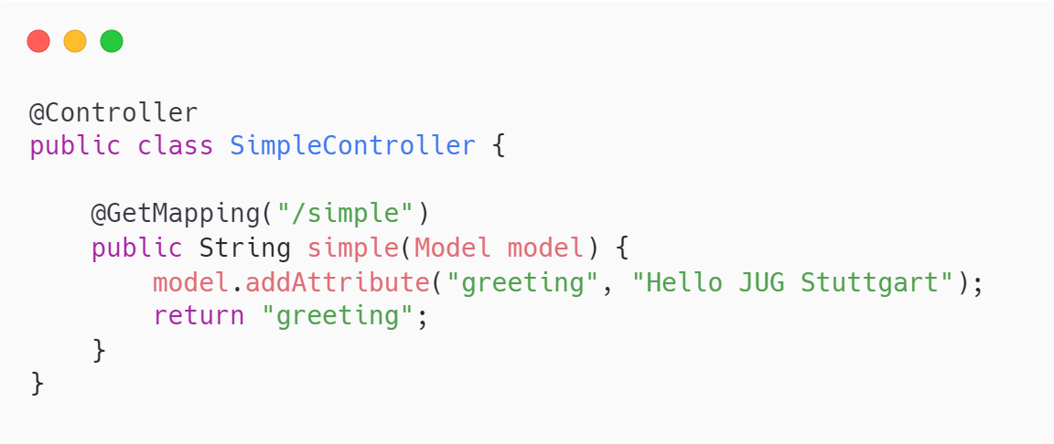
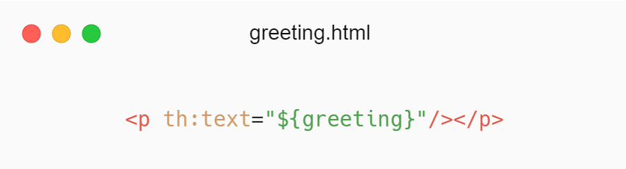
Notes:
The first problem with MVC is that your controller needs to know what variables are used in your template, tightly coupling your controller to your View. There are no compile time checks if the template has all model properties available.
This will get especially spicy if you reuse templates inside other templates. Because if you want to change the template variables you need to change the model in every controller method that returns this template.

Slide 56
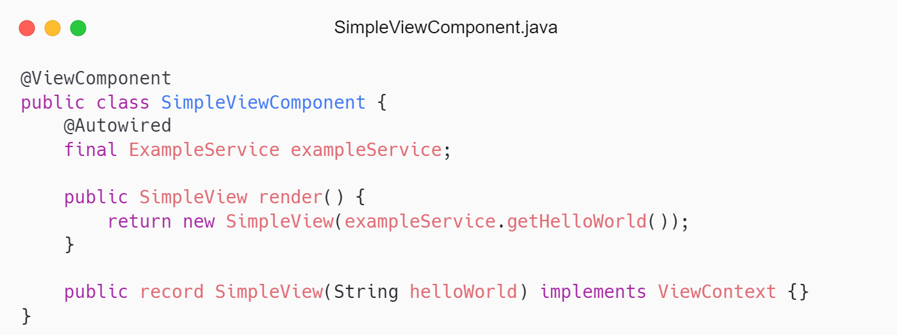
https://carbon.now.sh/?bg=rgba%28255%2C255%2C255%2C1%29&t=one-light&wt=sharp&l=text%2Fx-java&width=700&ds=false&dsyoff=20px&dsblur=68px&wc=true&wa=false&pv=0px&ph=0px&ln=false&fl=1&fm=Hack&fs=14px&lh=133%25&si=false&es=2x&wm=false&code=%2540ViewComponent%250Apublic%2520class%2520SimpleViewComponent%2520%257B%250A%2520%2520%2509%2540Autowired%250A%2520%2520%2520%2520final%2520ExampleService%2520exampleService%253B%250A%2520%2520%250A%2509public%2520SimpleView%2520render%28%29%2520%257B%250A%2509%2509return%2520new%2520SimpleView%28exampleService.getHelloWorld%28%29%29%253B%250A%2520%2520%2520%2520%257D%250A%2520%2520%250A%2520%2520%2520%2520public%2520record%2520SimpleView%28String%2520helloWorld%29%2520implements%2520ViewContext%2520%257B%257D%250A%257D&tb=SimpleViewComponent.java
https://carbon.now.sh/?bg=rgba%28255%2C255%2C255%2C1%29&t=one-light&wt=sharp&l=htmlmixed&width=806.5&ds=false&dsyoff=20px&dsblur=68px&wc=true&wa=false&pv=0px&ph=0px&ln=false&fl=1&fm=Hack&fs=14px&lh=133%25&si=false&es=2x&wm=false&code=%253C%21--%252F*%2540thymesVar%2520id%253D%2522simpleView%2522%2520%250A%2509type%253D%2522de.tschuehly.example.thymeleafjava.web.simple.SimpleViewComponent.SimpleView%2522*%252F--%253E%250A%253Cdiv%2520th%253Atext%253D%2522%2524%257BsimpleView.helloWorld%28%29%257D%2522%253E%253C%252Fdiv%253E&tb=SimpleViewComponent.html
Notes:
We can solve this with Spring ViewComponent.
We create a component with the @ViewComponent Annotation, making it a Spring managed bean. Meaning we can use dependency injection like any other Spring Component.
The ViewComponent needs to define a method that returns a ViewContext implementation, here it is the render method.
Inside the render method we return the SimpleView ViewContext record that declares a helloWorld parameter.

Slide 57
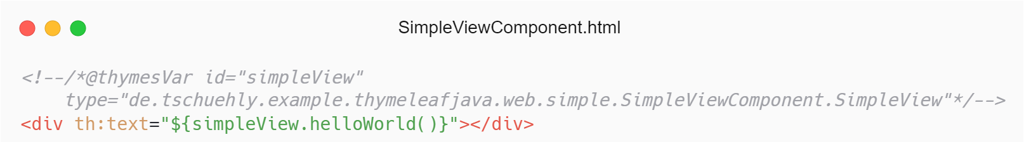
https://carbon.now.sh/?bg=rgba%28255%2C255%2C255%2C1%29&t=one-light&wt=sharp&l=text%2Fx-java&width=700&ds=false&dsyoff=20px&dsblur=68px&wc=true&wa=false&pv=0px&ph=0px&ln=false&fl=1&fm=Hack&fs=14px&lh=133%25&si=false&es=2x&wm=false&code=%2540ViewComponent%250Apublic%2520class%2520SimpleViewComponent%2520%257B%250A%2520%2520%2509%2540Autowired%250A%2520%2520%2520%2520final%2520ExampleService%2520exampleService%253B%250A%2520%2520%250A%2509public%2520SimpleView%2520render%28%29%2520%257B%250A%2509%2509return%2520new%2520SimpleView%28exampleService.getHelloWorld%28%29%29%253B%250A%2520%2520%2520%2520%257D%250A%2520%2520%250A%2520%2520%2520%2520public%2520record%2520SimpleView%28String%2520helloWorld%29%2520implements%2520ViewContext%2520%257B%257D%250A%257D&tb=SimpleViewComponent.java
https://carbon.now.sh/?bg=rgba%28255%2C255%2C255%2C1%29&t=one-light&wt=sharp&l=htmlmixed&width=806.5&ds=false&dsyoff=20px&dsblur=68px&wc=true&wa=false&pv=0px&ph=0px&ln=false&fl=1&fm=Hack&fs=14px&lh=133%25&si=false&es=2x&wm=false&code=%253C%21--%252F*%2540thymesVar%2520id%253D%2522simpleView%2522%2520%250A%2509type%253D%2522de.tschuehly.example.thymeleafjava.web.simple.SimpleViewComponent.SimpleView%2522*%252F--%253E%250A%253Cdiv%2520th%253Atext%253D%2522%2524%257BsimpleView.helloWorld%28%29%257D%2522%253E%253C%252Fdiv%253E&tb=SimpleViewComponent.html
Notes:
A ViewComponent needs to have a template with the same name as the component in the same package.
Here you can see the thymeleaf template where we can access the SimpleView ViewContext record and display the helloWorld property that is fetched from the exampleService.

Slide 58
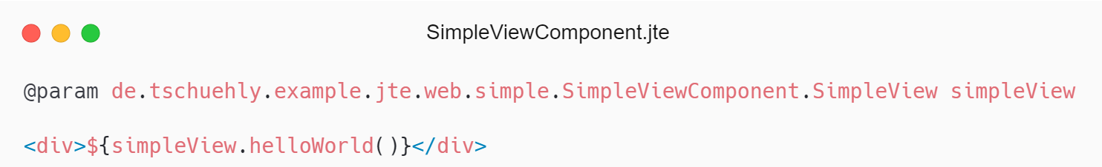
https://carbon.now.sh/?bg=rgba%28255%2C255%2C255%2C1%29&t=one-light&wt=sharp&l=text%2Fx-java&width=700&ds=false&dsyoff=20px&dsblur=68px&wc=true&wa=false&pv=0px&ph=0px&ln=false&fl=1&fm=Hack&fs=14px&lh=133%25&si=false&es=2x&wm=false&code=%2540ViewComponent%250Apublic%2520class%2520SimpleViewComponent%2520%257B%250A%2520%2520%2509%2540Autowired%250A%2520%2520%2520%2520final%2520ExampleService%2520exampleService%253B%250A%2520%2520%250A%2509public%2520SimpleView%2520render%28%29%2520%257B%250A%2509%2509return%2520new%2520SimpleView%28exampleService.getHelloWorld%28%29%29%253B%250A%2520%2520%2520%2520%257D%250A%2520%2520%250A%2520%2520%2520%2520public%2520record%2520SimpleView%28String%2520helloWorld%29%2520implements%2520ViewContext%2520%257B%257D%250A%257D&tb=SimpleViewComponent.java
https://carbon.now.sh/?bg=rgba%28255%2C255%2C255%2C1%29&t=one-light&wt=sharp&l=text%2Fx-java&width=742.25&ds=false&dsyoff=20px&dsblur=68px&wc=true&wa=false&pv=0px&ph=0px&ln=false&fl=1&fm=Hack&fs=14px&lh=133%25&si=false&es=2x&wm=false&code=%2540param%2520de.tschuehly.example.jte.web.simple.SimpleViewComponent.SimpleView%2520simpleView%250A%250A%253Cdiv%253E%2524%257BsimpleView.helloWorld%28%29%257D%253C%252Fdiv%253E&tb=SimpleViewComponent.jte
Notes:
We can also use JTE, as template language where we define the SimpleView ViewContext as parameter and then access it in the JTE expression and render the helloWorld property inside the div element.

Slide 59
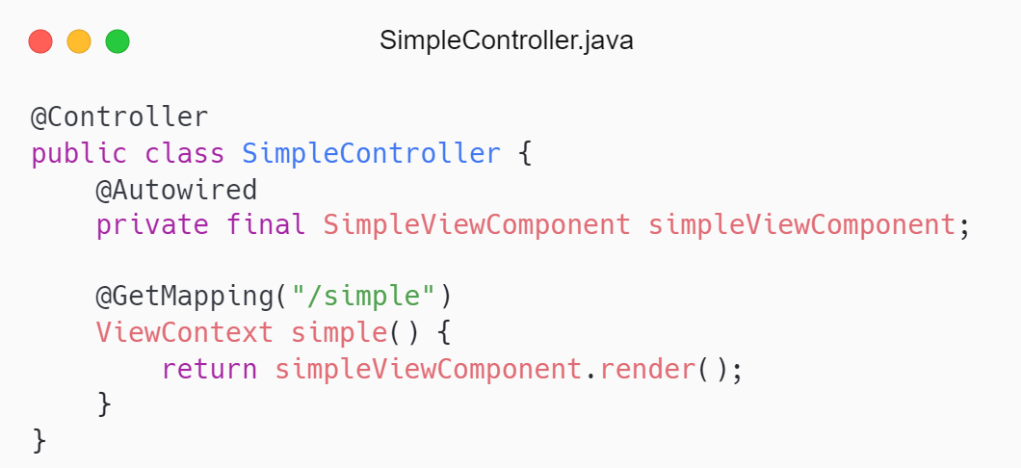
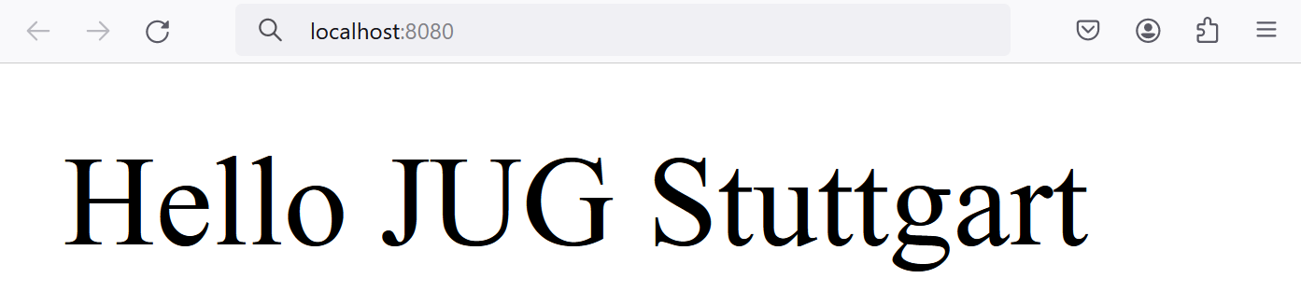
https://carbon.now.sh/?bg=rgba%28255%2C255%2C255%2C1%29&t=one-light&wt=sharp&l=text%2Fx-java&width=530.25&ds=false&dsyoff=20px&dsblur=68px&wc=true&wa=false&pv=0px&ph=0px&ln=false&fl=1&fm=Hack&fs=14px&lh=133%25&si=false&es=2x&wm=false&code=%2540Controller%250Apublic%2520class%2520SimpleController%2520%257B%250A%2520%2520%2509%2540Autowired%250A%2520%2520%2520%2520private%2520final%2520SimpleViewComponent%2520simpleViewComponent%253B%250A%2520%2520%250A%2520%2520%2520%2520%2540GetMapping%28%2522%252Fsimple%2522%29%250A%2520%2520%2520%2520ViewContext%2520simple%28%29%2520%257B%250A%2520%2520%2520%2520%2520%2520%2520%2520return%2520simpleViewComponent.render%28%29%253B%250A%2520%2520%2520%2520%257D%250A%257D&tb=SimpleController.java
Notes:
To display the ViewComponent we can just call the render method on the Autowired SimpleViewComponent and return that in our Controller.
We now have clear separation of concerns, Controllers are responsible for routing, and not for data fetching.
The ViewComponent is responsible that the HTML Template has all data available for correct rendering.

Slide 60
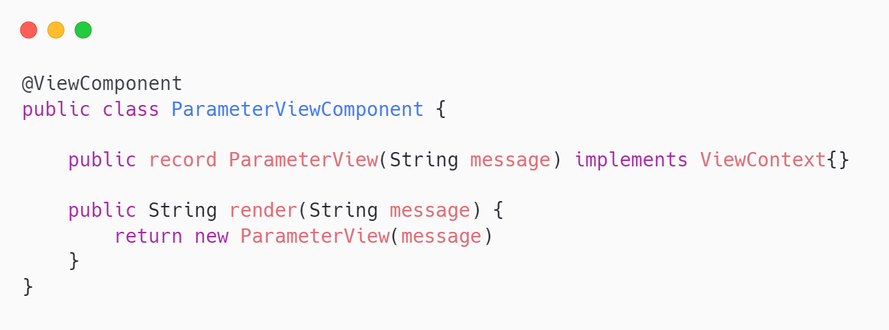
https://carbon.now.sh/?bg=rgba%28255%2C255%2C255%2C1%29&t=one-light&wt=sharp&l=text%2Fx-java&width=652&ds=false&dsyoff=20px&dsblur=68px&wc=true&wa=false&pv=0px&ph=0px&ln=false&fl=1&fm=Hack&fs=14px&lh=133%25&si=false&es=2x&wm=false&code=%2540ViewComponent%250Apublic%2520class%2520ParameterViewComponent%2520%257B%250A%250A%2520%2520%2509public%2520record%2520ParameterView%28String%2520message%29%2520implements%2520ViewContext%257B%257D%250A%2520%2520%250A%2509public%2520String%2520render%28String%2520message%29%2520%257B%250A%2509%2509return%2520new%2520ParameterView%28message%29%250A%2509%257D%250A%257D&tb=
Notes:
To create a reusable ViewComponent we can parameterize it.
They don’t do data fetching, and instead rely on the parent component to pass the data via the parameters, meaning we can easily reuse this component all over our application.
This gives us the ability to easily create type safe templates for commonly used UI patterns.

Slide 61
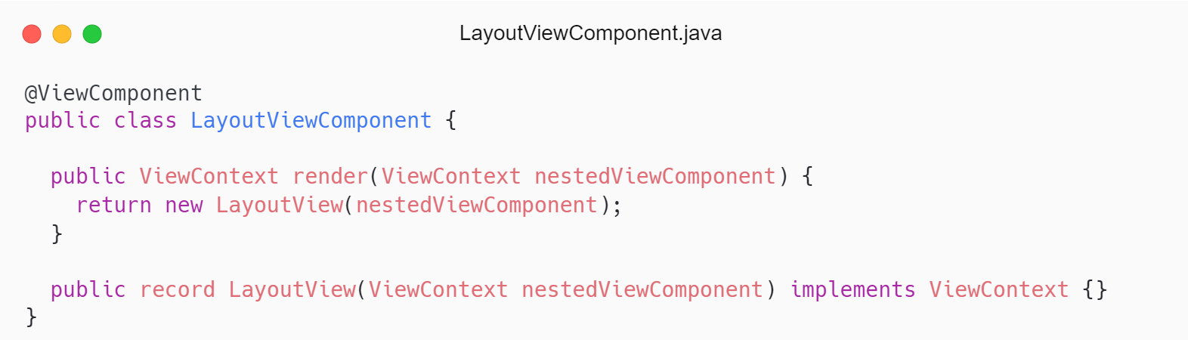
https://carbon.now.sh/?bg=rgba%28255%2C255%2C255%2C1%29&t=one-light&wt=sharp&l=text%2Fx-java&width=785.5&ds=false&dsyoff=20px&dsblur=68px&wc=true&wa=false&pv=0px&ph=0px&ln=false&fl=1&fm=Hack&fs=14px&lh=133%25&si=false&es=2x&wm=false&code=%2540ViewComponent%250Apublic%2520class%2520LayoutViewComponent%2520%257B%250A%250A%2520%2520public%2520ViewContext%2520render%28ViewContext%2520nestedViewComponent%29%2520%257B%250A%2520%2520%2509return%2520new%2520LayoutView%28nestedViewComponent%29%253B%250A%2520%2520%257D%250A%250A%2520%2520public%2520record%2520LayoutView%28ViewContext%2520nestedViewComponent%29%2520implements%2520ViewContext%2520%257B%257D%250A%257D&tb=LayoutViewComponent.java
https://carbon.now.sh/?bg=rgba%28255%2C255%2C255%2C1%29&t=one-light&wt=sharp&l=text%2Fx-java&width=823.5&ds=false&dsyoff=20px&dsblur=68px&wc=true&wa=false&pv=0px&ph=0px&ln=false&fl=1&fm=Hack&fs=14px&lh=133%25&si=false&es=2x&wm=false&code=%253Cnav%253E%253C%252Fnav%253E%250A%253C%21--%252F*%2540thymesVar%2520id%253D%2522layoutView%2522%250A%2509type%253D%2522de.tschuehly.example.thymeleafjava.web.layout.LayoutViewComponent.LayoutView%2522*%252F--%253E%250A%253Cdiv%2520view%253Acomponent%253D%2522%2524%257BlayoutView.nestedViewComponent%28%29%257D%2522%253E%253C%252Fdiv%253E%250A%253Cfooter%253E%253C%252Ffooter%253E&tb=LayoutViewComponent.html
Notes:
We can also pass a ViewContext in our parameter and render them inside other ViewComponents enabling us to create layouts.

Slide 62
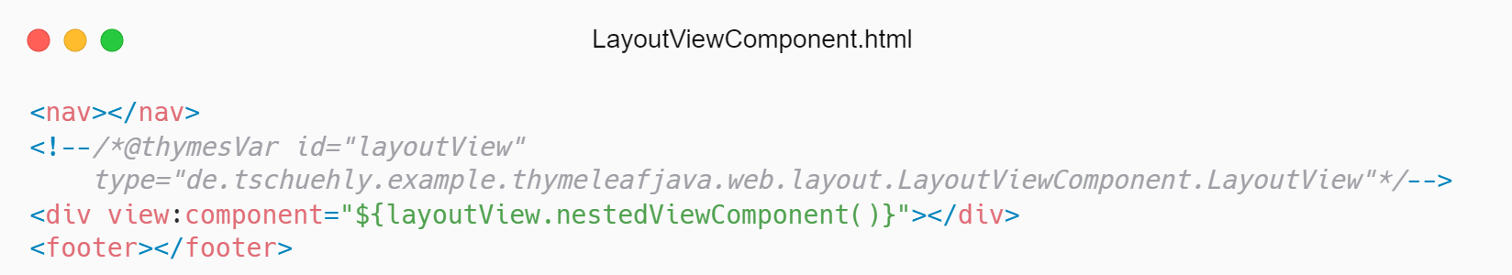
https://carbon.now.sh/?bg=rgba%28255%2C255%2C255%2C1%29&t=one-light&wt=sharp&l=text%2Fx-java&width=785.5&ds=false&dsyoff=20px&dsblur=68px&wc=true&wa=false&pv=0px&ph=0px&ln=false&fl=1&fm=Hack&fs=14px&lh=133%25&si=false&es=2x&wm=false&code=%2540ViewComponent%250Apublic%2520class%2520LayoutViewComponent%2520%257B%250A%250A%2520%2520public%2520ViewContext%2520render%28ViewContext%2520nestedViewComponent%29%2520%257B%250A%2520%2520%2509return%2520new%2520LayoutView%28nestedViewComponent%29%253B%250A%2520%2520%257D%250A%250A%2520%2520public%2520record%2520LayoutView%28ViewContext%2520nestedViewComponent%29%2520implements%2520ViewContext%2520%257B%257D%250A%257D&tb=LayoutViewComponent.java
https://carbon.now.sh/?bg=rgba%28255%2C255%2C255%2C1%29&t=one-light&wt=sharp&l=text%2Fx-java&width=823.5&ds=false&dsyoff=20px&dsblur=68px&wc=true&wa=false&pv=0px&ph=0px&ln=false&fl=1&fm=Hack&fs=14px&lh=133%25&si=false&es=2x&wm=false&code=%253Cnav%253E%253C%252Fnav%253E%250A%253C%21--%252F*%2540thymesVar%2520id%253D%2522layoutView%2522%250A%2509type%253D%2522de.tschuehly.example.thymeleafjava.web.layout.LayoutViewComponent.LayoutView%2522*%252F--%253E%250A%253Cdiv%2520view%253Acomponent%253D%2522%2524%257BlayoutView.nestedViewComponent%28%29%257D%2522%253E%253C%252Fdiv%253E%250A%253Cfooter%253E%253C%252Ffooter%253E&tb=LayoutViewComponent.html
Notes:
With Thymeleaf, we use the view:component attribute and reference the nestedViewComponent ViewContext object. This will replace the div with the rendered HTML of the nestedViewComponent

Slide 63
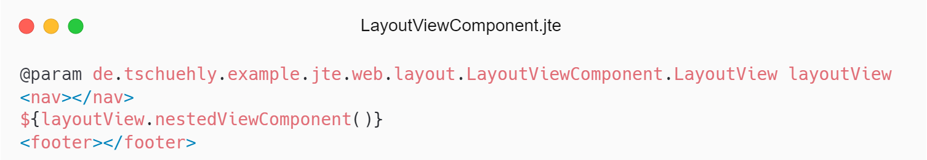
https://carbon.now.sh/?bg=rgba%28255%2C255%2C255%2C1%29&t=one-light&wt=sharp&l=text%2Fx-java&width=785.5&ds=false&dsyoff=20px&dsblur=68px&wc=true&wa=false&pv=0px&ph=0px&ln=false&fl=1&fm=Hack&fs=14px&lh=133%25&si=false&es=2x&wm=false&code=%2540ViewComponent%250Apublic%2520class%2520LayoutViewComponent%2520%257B%250A%250A%2520%2520public%2520ViewContext%2520render%28ViewContext%2520nestedViewComponent%29%2520%257B%250A%2520%2520%2509return%2520new%2520LayoutView%28nestedViewComponent%29%253B%250A%2520%2520%257D%250A%250A%2520%2520public%2520record%2520LayoutView%28ViewContext%2520nestedViewComponent%29%2520implements%2520ViewContext%2520%257B%257D%250A%257D&tb=LayoutViewComponent.java
https://carbon.now.sh/?bg=rgba%28255%2C255%2C255%2C1%29&t=one-light&wt=sharp&l=text%2Fx-java&width=823.5&ds=false&dsyoff=20px&dsblur=68px&wc=true&wa=false&pv=0px&ph=0px&ln=false&fl=1&fm=Hack&fs=14px&lh=133%25&si=false&es=2x&wm=false&code=%253Cnav%253E%253C%252Fnav%253E%250A%253C%21--%252F*%2540thymesVar%2520id%253D%2522layoutView%2522%250A%2509type%253D%2522de.tschuehly.example.thymeleafjava.web.layout.LayoutViewComponent.LayoutView%2522*%252F--%253E%250A%253Cdiv%2520view%253Acomponent%253D%2522%2524%257BlayoutView.nestedViewComponent%28%29%257D%2522%253E%253C%252Fdiv%253E%250A%253Cfooter%253E%253C%252Ffooter%253E&tb=LayoutViewComponent.html
Notes:
With JTE we use the nestedViewComponent ViewContext inside a JTE Expression and JTE will insert the rendered HTML of the nestedViewComponent at this location.

Slide 64
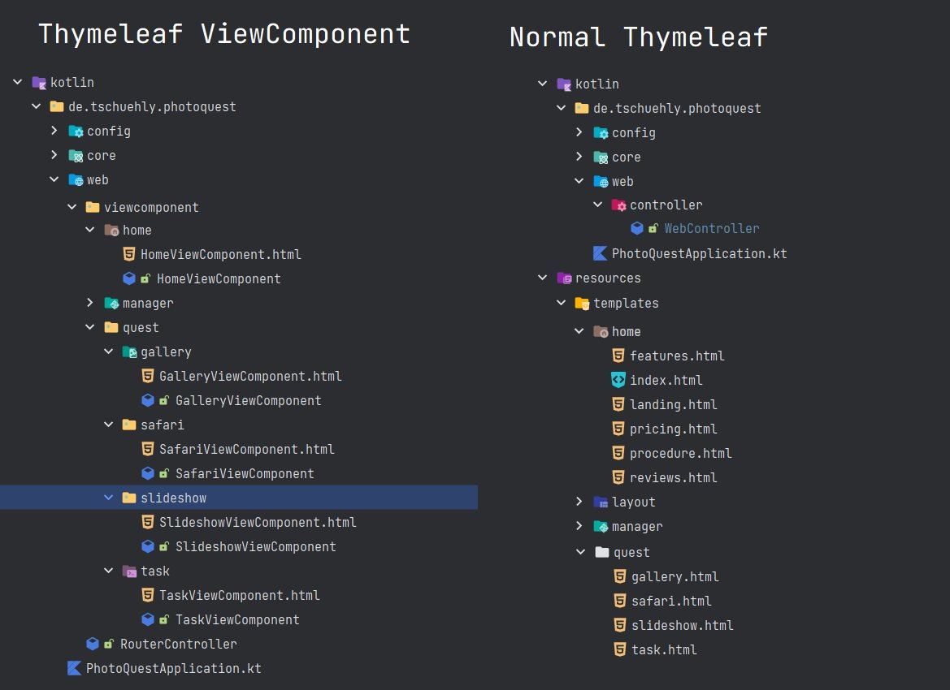
java
Notes:
The next issue with MVC is that the templates are located in the resources folder, but the Controller is in the java directory.
There is a strong disconnect between where the data for the templates is aggregated and where the templates use that data.
This structure provides very low cohesion and adds cognitive load when trying develop.

Slide 65
java
java
Notes:
With Spring ViewComponent we can create a highly cohesive code structure because each template needs to live in the same package as the data provider. What this also allows is a completely feature based package structure.
You can see here that with MVC our slideshow feature is split in two completely separated files while with ViewComponents our whole feature is nicely bundled into a package.

Slide 66
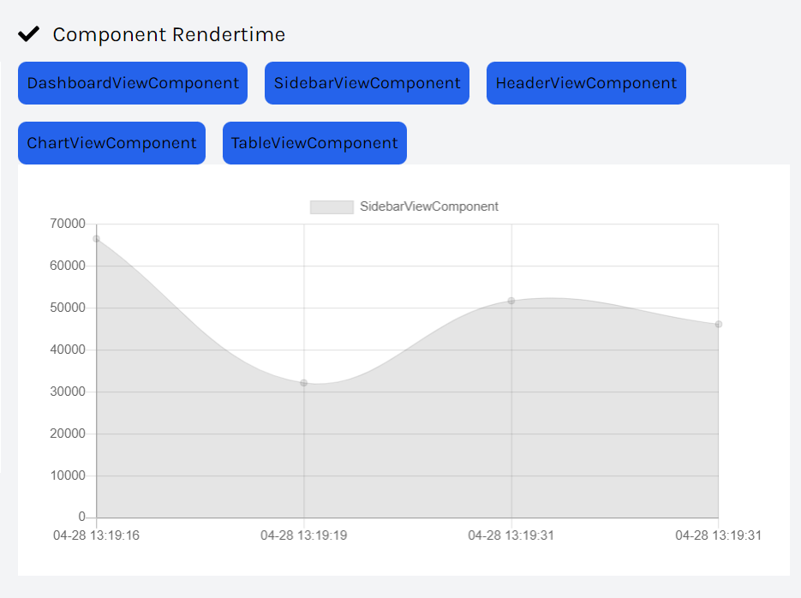
Notes:
Now we will look at how Spring ViewComponent integrates with HTMX.
In this example we created an AnalyticsService that measures the time to render each ViewComponent using the Aspect Oriented Programming support of Spring.
We have a button for each ViewComponent, when clicked the rendertimes are displayed as a line chart.
As a heads up the code examples from now on are in Kotlin.

Slide 67
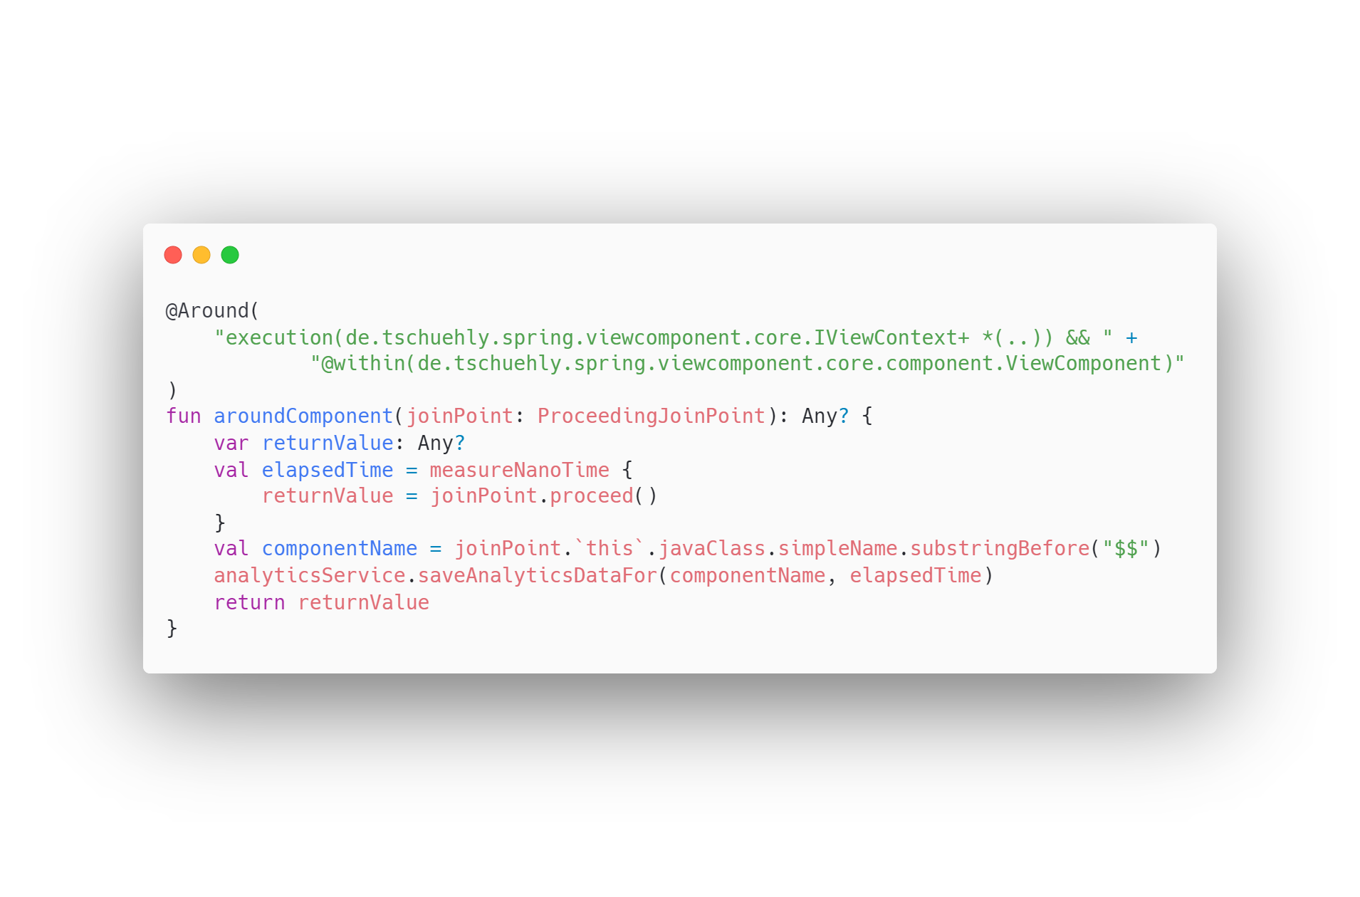
Notes:
We create a simple Aspect that measures the render time of each ViewComponent. We get the name of the component and save the time referenced by the componentName into the AnalyticsService.

Slide 68
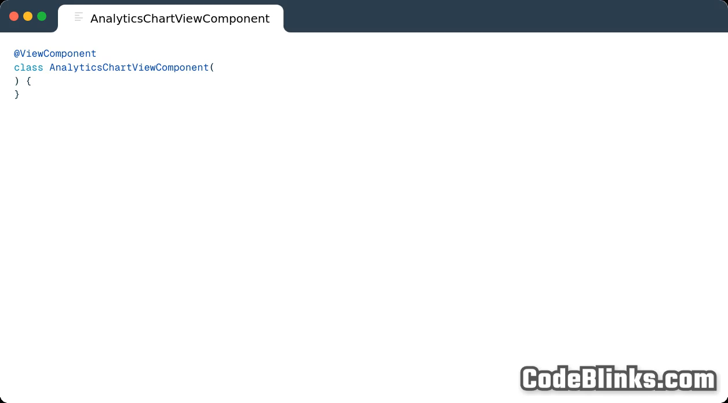
Notes:
In the AnalyticsChartViewComponent we autowire the analyticsService and the ChartViewComponent.

Slide 69
Notes:
Then we create a ViewContext class that has a ViewContext field.

Slide 70
Notes:
In the render method we create a new instance of the AnalyticsChartContext

Slide 71
Notes:
We call the render method of the chartViewComponent we autowired.
As you can see the ChartViewComponent self describes the API via a ChartDetails class.
We can set what type of chart we want, the width and height, the name, the data and corresponding datapoint labels.

Slide 72
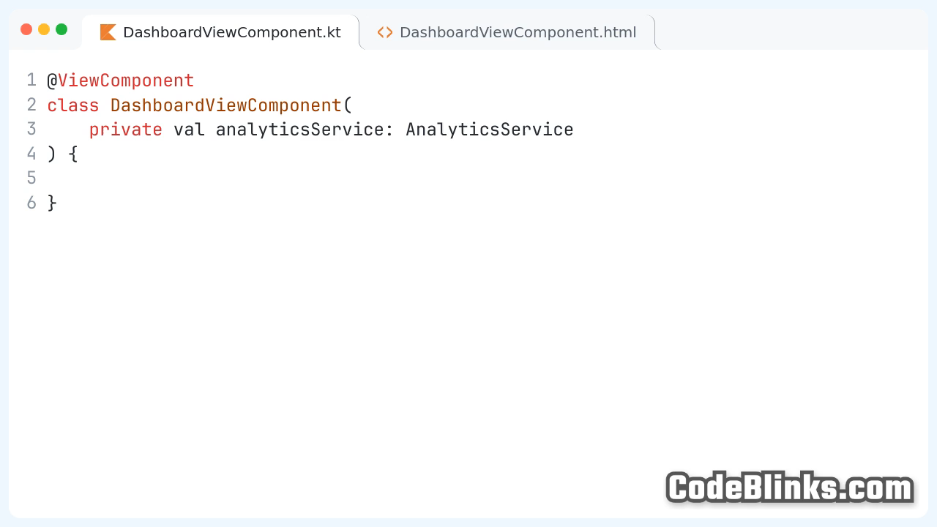
Notes:
Then we create a DashboardViewComponent and autowire the analyticsService.
We create a ViewContext class with a renderTimeLabelList field, as we reference each component by its name.

Slide 73
Notes:
We define a render method where we create a new instance of the DashboardContext and pass the labelList we retreive from the AnalyticsService.

Slide 74
Notes:
In the corresponding DashboardViewComponent.html we will loop over this List and show a button element for each using the Thymeleaf th:each attribute.

Slide 75
Notes:
Then we will set the button text with the th:text attribute to the label value.

Slide 76
Notes:
Now we will add the hx-get attribute and define the URL /linechartComponent with the attribute name=label.
This will create an HTTP GET request with a requestparameter with the value of the label variable.

Slide 77
Notes:
Now we define a hx-trigger attribute that will automatically trigger the request for the first element on page load, or when it is clicked.

Slide 78
https://codeblinks.com/?codeBlinks=%7B%22state%22%3A%7B%22resolution%22%3A%22720p%22%2C%22header%22%3Atrue%2C%22font%22%3A%22JetBrains_Mono%22%2C%22padding%22%3A12%2C%22codePadding%22%3A24%2C%22borderRadius%22%3A16%2C%22fileTabs%22%3Atrue%2C%22theme%22%3A%22github-light%22%2C%22background%22%3A%7B%22backgroundColor%22%3A%22AliceBlue%22%7D%2C%22windowControls%22%3A%22Mac%22%2C%22duration%22%3A%222%22%2C%22fontSize%22%3A%2224%22%2C%22transparency%22%3Afalse%2C%22lineNumbers%22%3Atrue%2C%22shadow%22%3Afalse%2C%22language%22%3A%22java%22%2C%22format%22%3A%22Landscape%22%2C%22blurCode%22%3Afalse%2C%22keyUpdateCount%22%3A0%7D%2C%22version%22%3A0%7D
Notes:
We define the swapping target with the hx-target attribute. It will tell htmx to swap the http response body with the div with the id “lineChart”

Slide 79
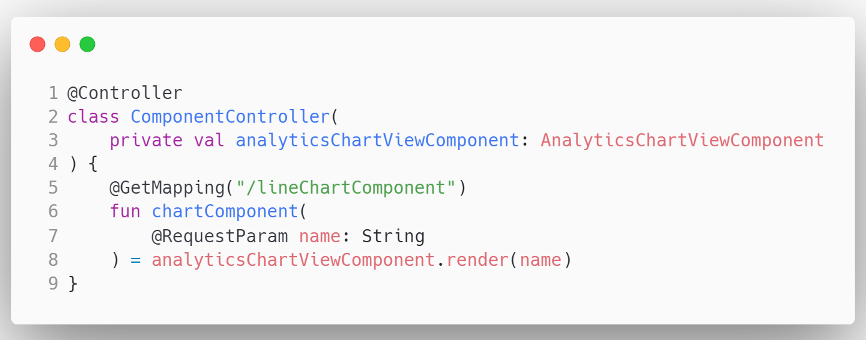
Notes:
The Last Step is to create a GetMapping with the component name as requestparameter and return the rendered AnalyticsChartViewComponent.

Slide 80
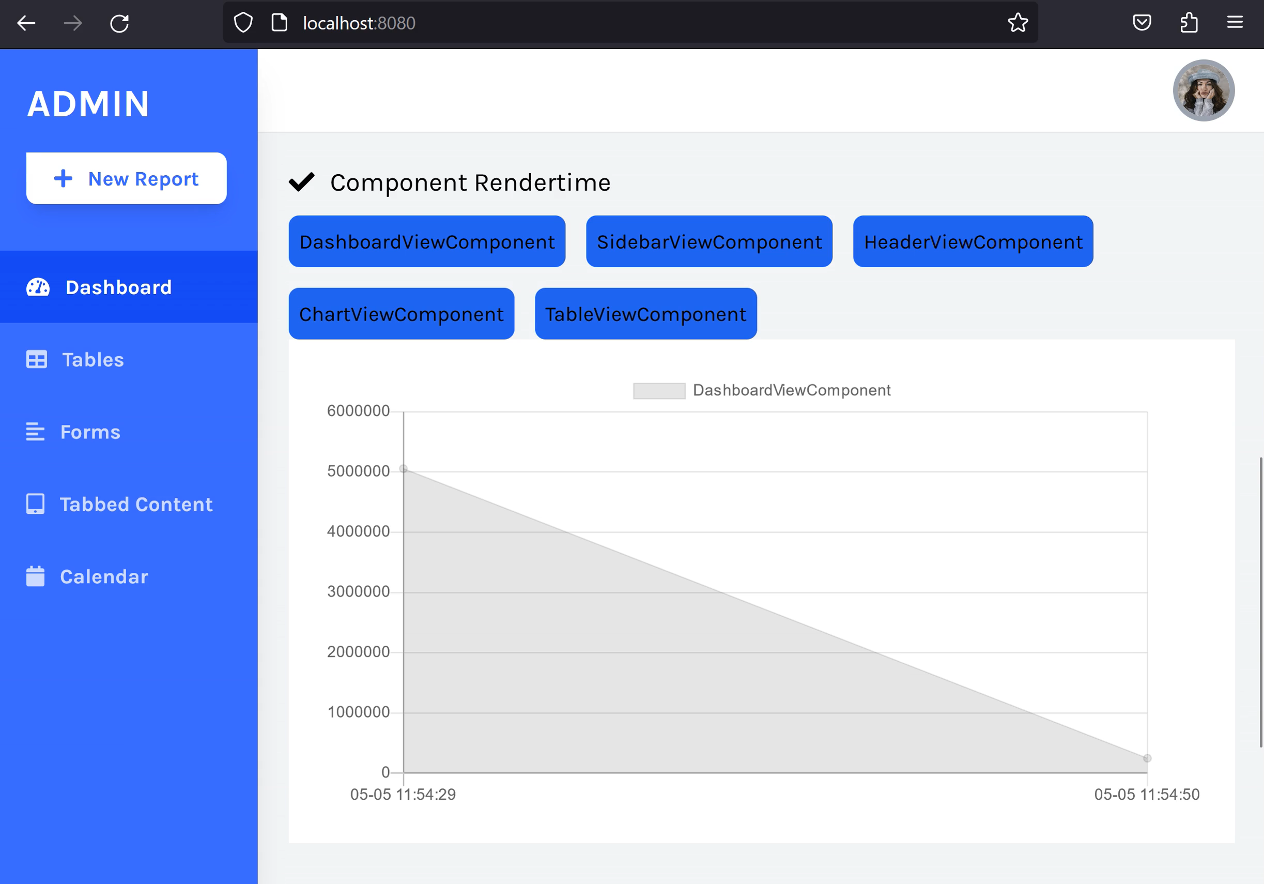
Notes:
Here is the example we just implemented. And as you can see that we have a fully interactive dashboard without any page refreshes.
The state of the chart is automatically updated with the newest server data. You can see this both on the ChartViewComponent and the DashboardComponent.

Slide 81
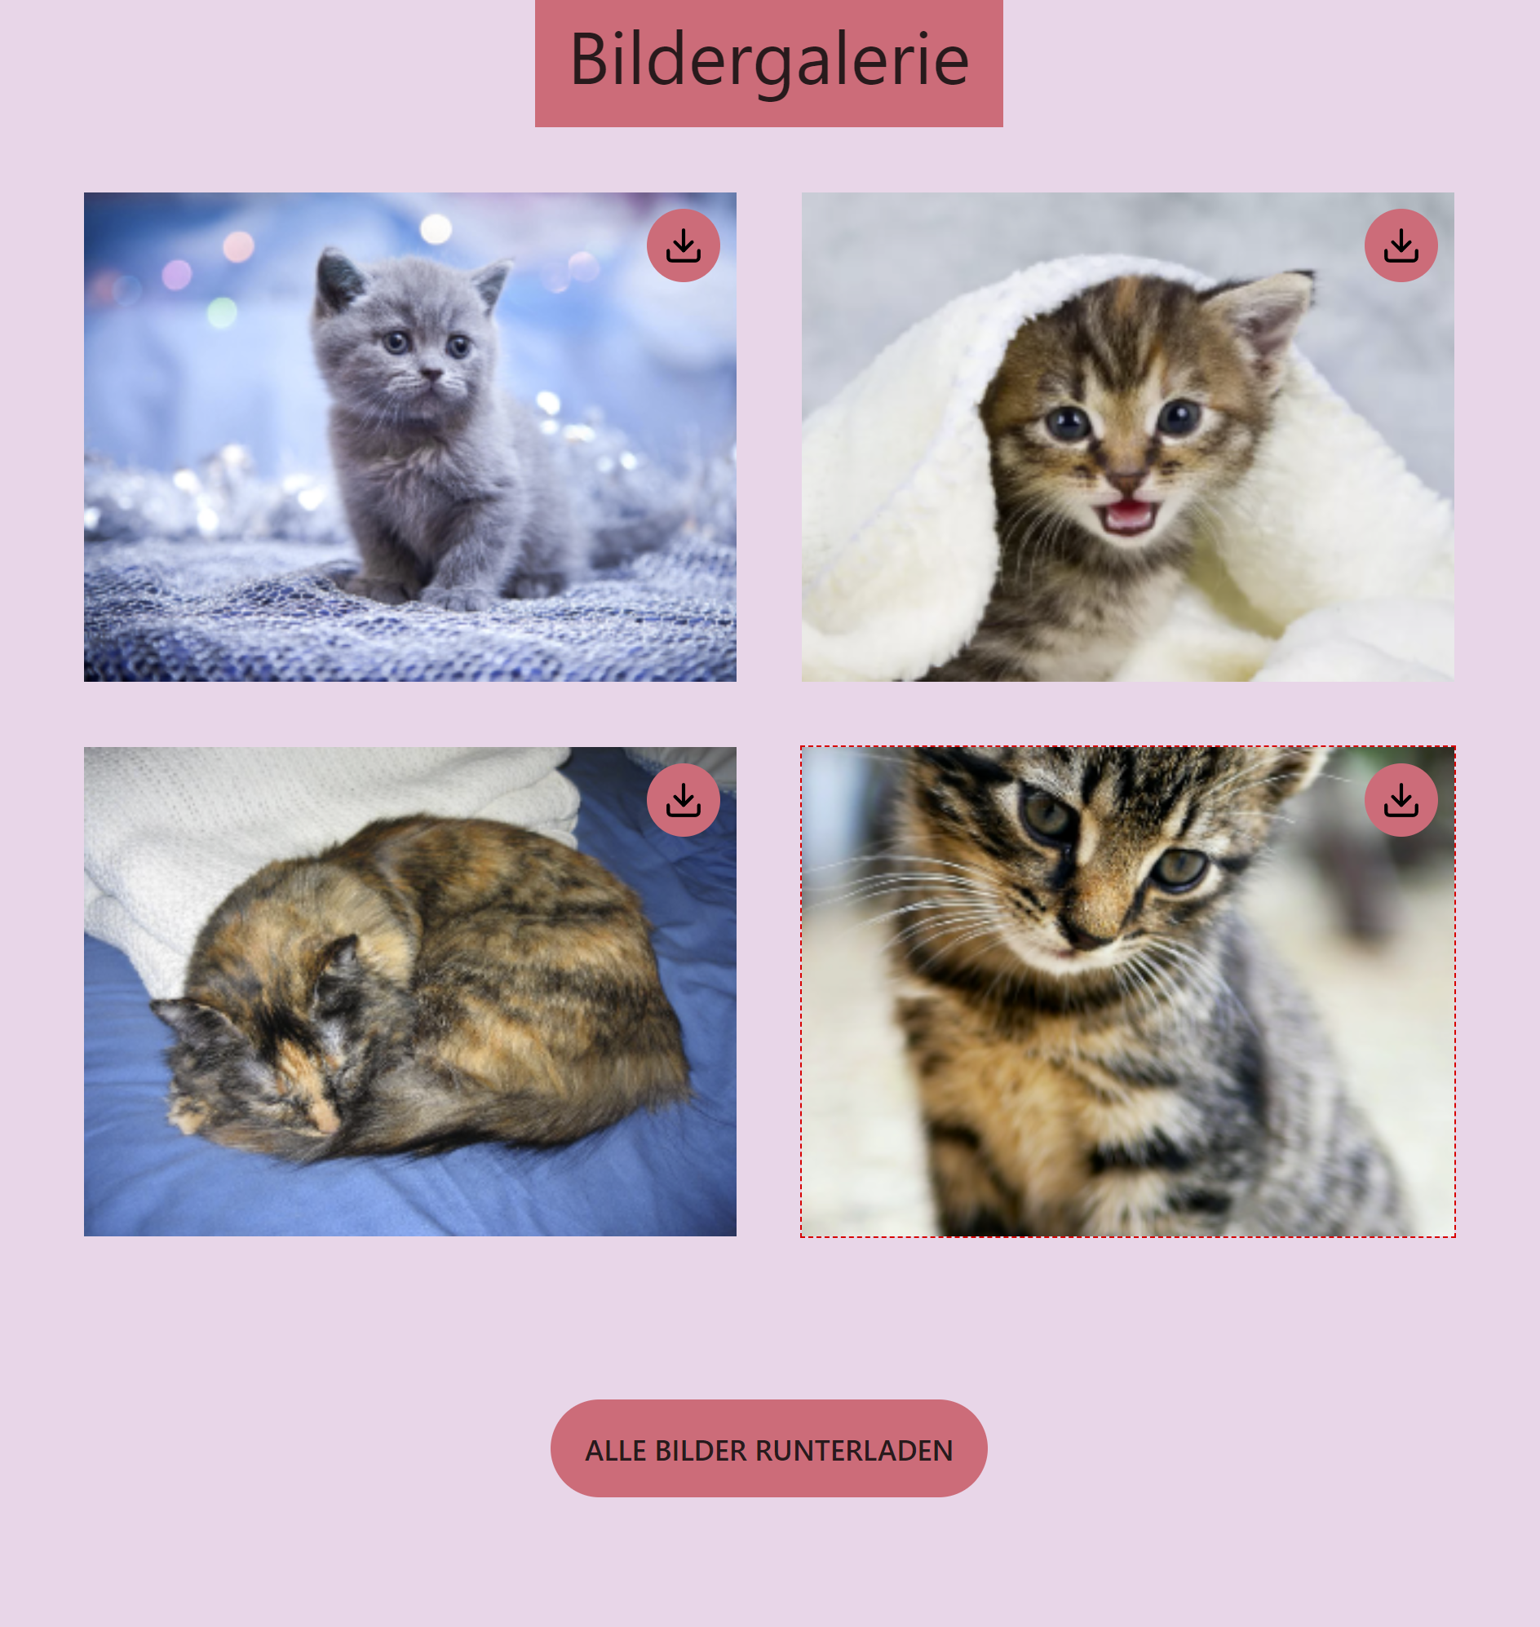
Notes:
Next we will look at an example that is running in production today for my SaaS wedding business.
We want to show images that are stored in an S3 Object storage in a Gallery.

Slide 82
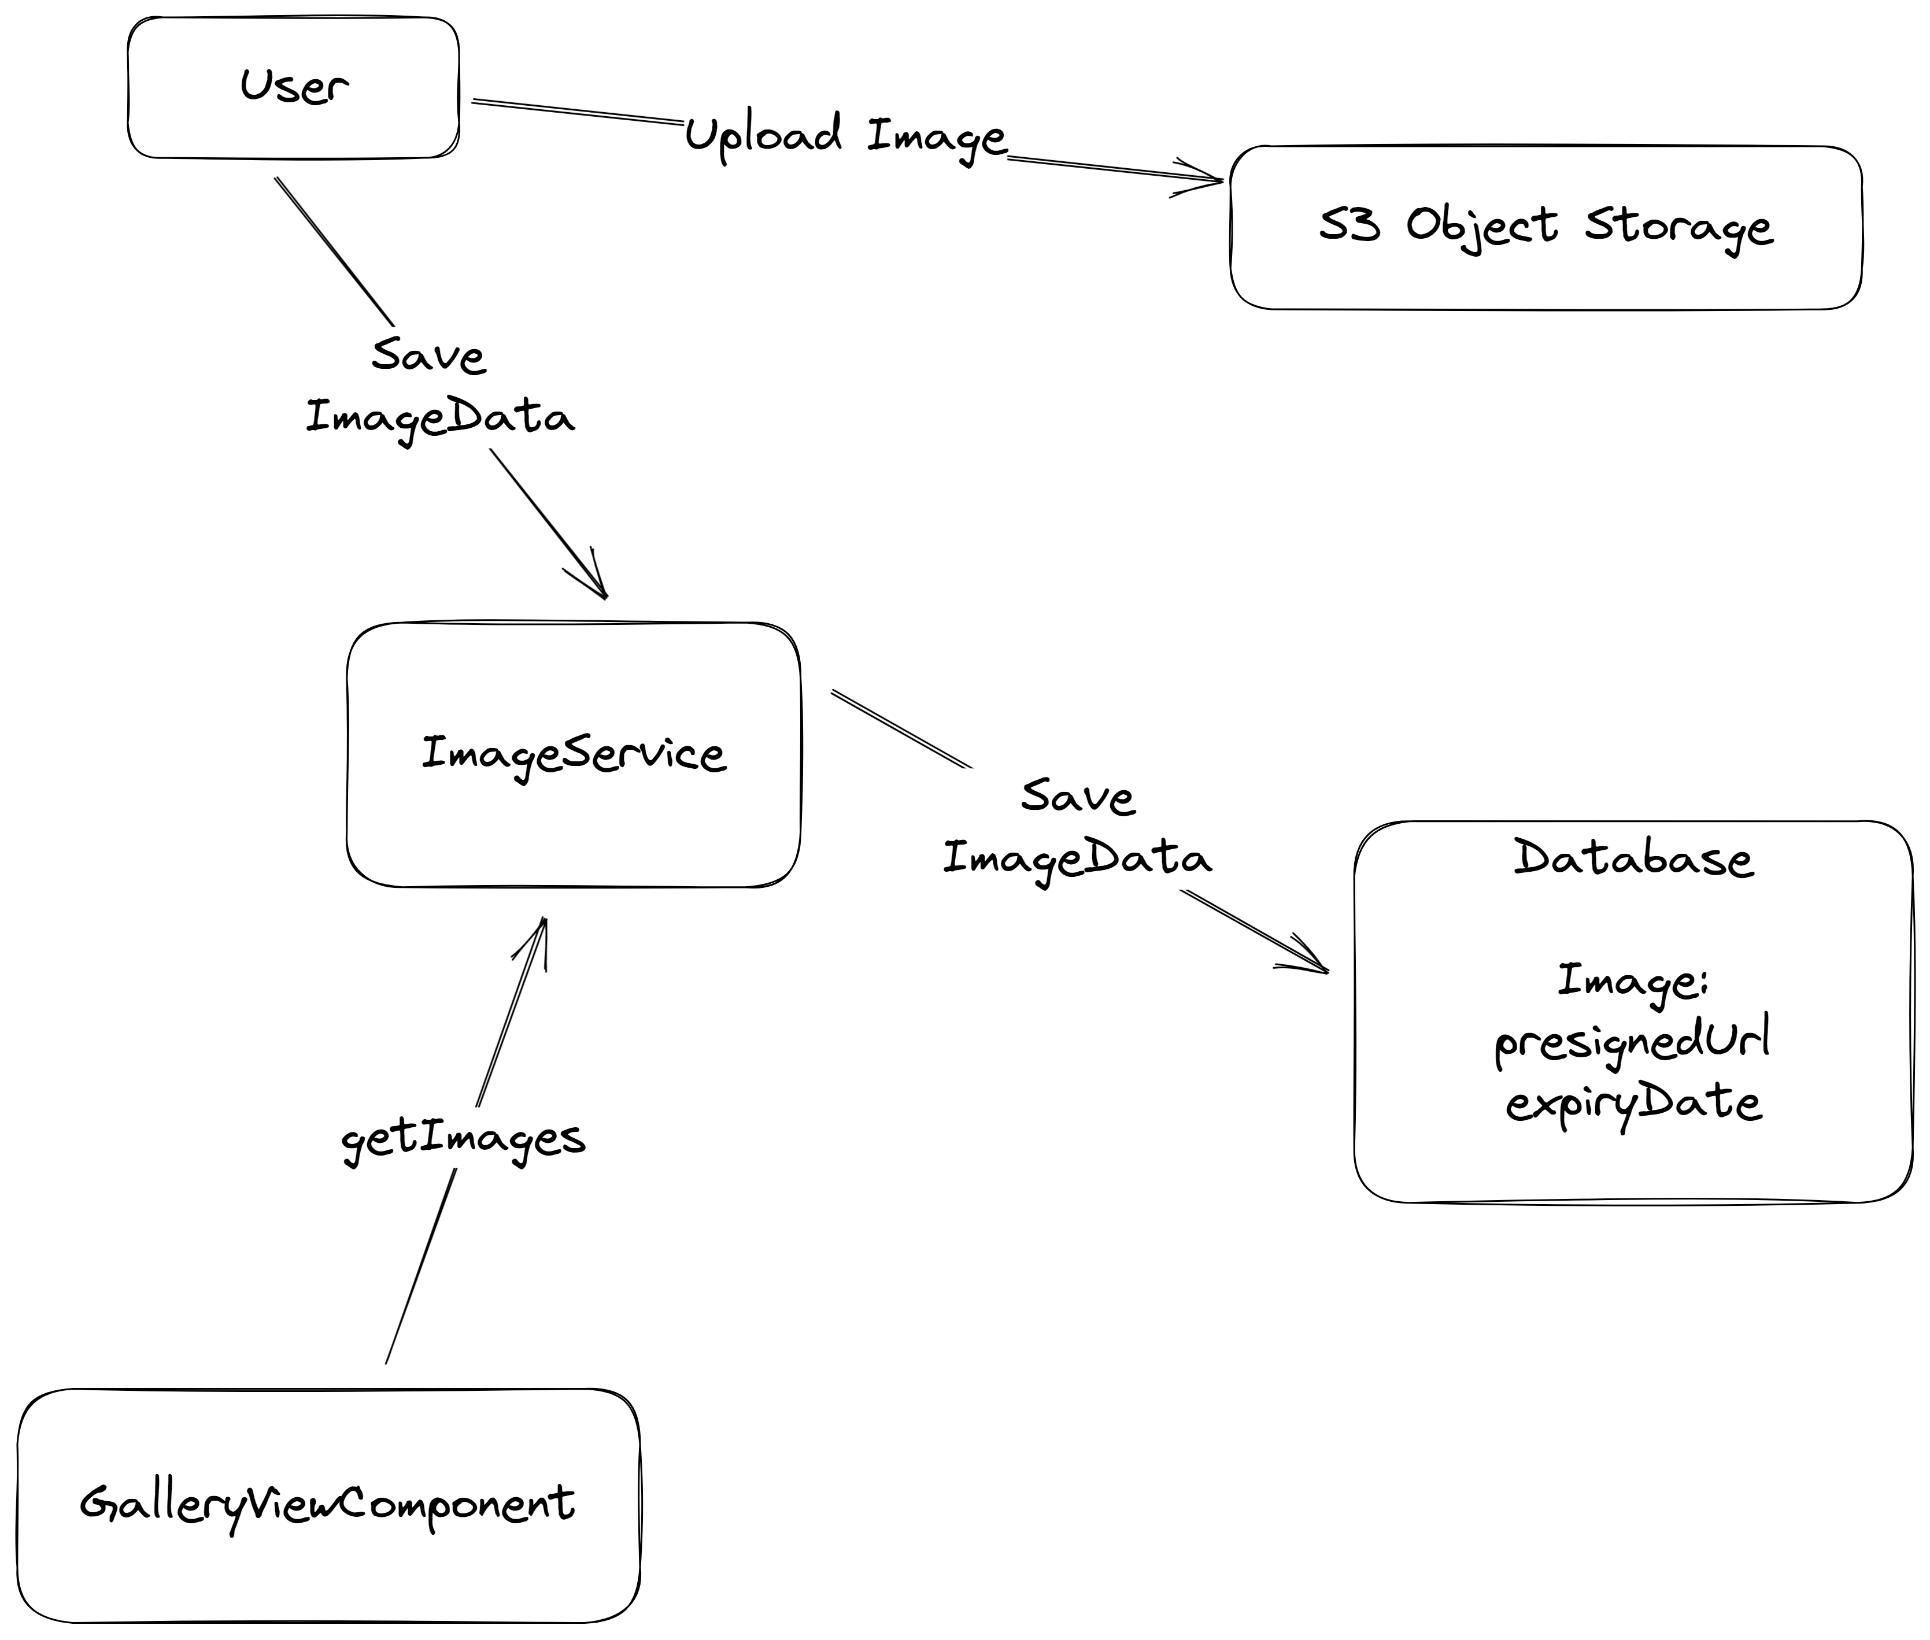
Notes:
The User uploads his images directly to the S3 object storage using presigned urls. Then the metadata of that object, including a presigned url to download that image is saved via an ImageService to our Database.
When rendering the GalleryViewComponent we retrieve all presignedUrls from our ImageService. But presigned urls have an expiryDate. After a maximum of 7 days the links are invalidated.
We could refresh our links every 7 days but we want to do that only on demand as this incurs API charges.

Slide 83
ImagePreviewComponent
Notes:
First we will look one individual image element. This element is rendered with the ImagePreviewComponent.

Slide 84
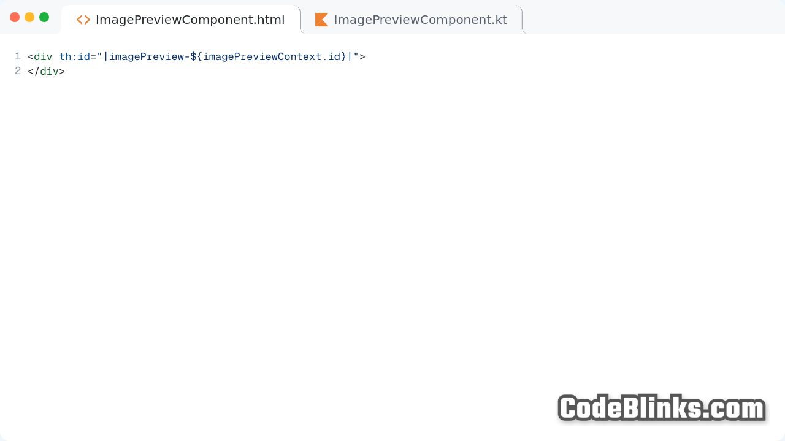
Notes:
In the ImagePreviewComponent Template, we can see how we achieve our on-demand presignedUrl refresh with htmx.
We start with a div element that has the id of the image.

Slide 85
Notes:
If the image presigned url is not expired it will display an image element with the src attribute set to the download url.

Slide 86
Notes:
If the image presigned url is expired thymeleaf will render a div with an hx-get to the refresh-preview endpoint that returns the same component but with a new presigned url that is not expired.
.

Slide 87
Notes:
We swap the whole html of this component with the hx-target value set to imagePreview dash imageId and the hx-swap attribute set to outerHTML

Slide 88
Notes:
The beauty comes with the hx-trigger=”revealed” attribute.
This means that the request will only be triggered when the html is rendered in the browser window.
With this behaviour S3 API calls will only made when really necessary.

Slide 89
Notes:
Next we will take a look at the corresponding Kotlin class. We autowire the imageService and create a ImagePreviewContext data class. It has an id of type Long, a downloadUrl and an isExpired Boolean.

Slide 90
Notes:
The render method has an Image parameter and a refreshImage Boolean.

Slide 91
Notes:
When the render method is called with the refreshImage parameter set to false, it will render the preview using the passed image object.

Slide 92
Notes:
If we pass true, the ViewComponent will get the image metadata with a refreshed downloadUrl pointing to our S3 object from the imageService and return the ImagePreviewContext with the new image.

Slide 93
Notes:
Next we will take a look at the GalleryViewComponent. It renders the full gallery of our images.

Slide 94

Notes:
We create a new ViewComponent and autowire the imageService and the imagePreviewComponent.

Slide 95
Notes:
Then we create a new GalleryViewContext data class that has a List of ViewContext as field.

Slide 96
Notes:
In this use case the gallery images are referenced by a subdomain.
We get the List of Images from the imageService.

Slide 97
Notes:
We then stream through the imagelist and map it to the list of imagePreview ViewContext objects using the imagePreviewComponent render method. Then we pass the imagePreviewList into our ViewContext class.

Slide 98
Notes:
The GalleryViewComponent template loops over the list of imagePreview ViewContext objects using the thymeleaf th:each attribute.

Slide 99
Notes:
Then we render each of them using the view:component attribute.

Slide 100

Notes:
Now we will look at the controller that is used for our gallery.
We autowire the galleryViewComponent.

Slide 101
Notes:
The /galerie endpoint returns the rendered galleryViewComponent, we saw before. We extract the subdomain from the request and pass it as parameter.

Slide 102
Notes:
The endpoint “/galerie/refresh-preview/imageId” returns the imagePreviewComponent with the refreshImage parameter set to true.
You can see the typesafe reusability possible with Spring ViewComponent.

Slide 103

Notes:
Finally, here’s the gallery in action!
As you can see new images are loaded on demand from the backend.

Slide 104


Notes:
As you can see when making a request to refresh-preview endpoint we get html back that is swapped inplace.

Slide 105

Notes:
Now if we want to further improve the interactivity of our Hypermedia Driven Applications we can use the optional constraint, code on demand of the REST architecture style.
By embedding JavaScript right inside our Components, we enable client-side interaction and we satisfy the Locality of Behaviour software design principle.

Slide 106

Notes:
We create a ToastViewComponent to show a notification.
We start with a div with the id toast-element. Then we create a script tag with the th:inline javascript attribute, so we can use thymeleaf expressions inside the script tag.
The script will automatically be executed when the HTML Snippet is returned by our Server.

Slide 107
Notes:
We create a hideToast function that will set the style display field to none, and hide the toast element.

Slide 108
Notes:
We use the setTimeout Function that will call the hideToast function, after the duration we passed with the render method parameter.

Slide 109
Notes:
Below that we show the message that we passed to the ViewComponent with the th:text attribute in a span element.

Slide 110
Notes:
With the onclick attribute of the button element we enable our users to hide the toast element earlier than the passed duration by clicking on the X.

Slide 111

Notes:
As I’ve just showed we can use vanilla JavaScript to enable client-side interactivity with Code On Demand.
I’ve really liked the approach of the AlpineJS library. It is a minimal tool to define interactive frontend behaviour directly inside HTML.

Slide 112

Notes:
I’ve created a sample ViewComponent that shows the power of AlpineJS in combination with Spring ViewComponent.
->
We want to create a TabComponent that we can reuse in our whole application that switches between content client side.

Slide 113

Notes:
We first define a AlpineTabViewComponent.kt that receives a List of Tabs as parameter
As you can see the power of the ViewComponent approach, each component can define it’s own API in a typesafe manner.

Slide 114
Notes:
We create an AlpineTabContext data class, that has a headerList and a contentList.

Slide 115
Notes:
We then map the TabList in the render method into a headerList and a contentList.

Slide 116
Notes:
Then we define a AlpineTabViewComponent.html that consists of the alpinejs x-data attribute defining a variable scope for this element. We define a openTab variable and set it to zero.

Slide 117
Notes:
Now we use the Thymeleaf th:each attribute to repeat the list element for each element in the headerlist. We create a button element in each list element and set the text of the button element to the header variable.

Slide 118
Notes:
Then we combine the alpineJs attribute x-on:click, with the thymeleaf element dot index variable. If the user clicks on the button the openTab variable will be set to the index of the element.

Slide 119
Notes:
Finally, to show the content we define a div that creates an element for each item in the contentList. With the th:text attribute we will set the innerHTML to the content value of the contentList

Slide 120
Notes:
We will add the alpine x dash show attribute that will toggle the visibility when the headerElement with the same index is selected.

Slide 121

Notes:
If we now look at the HTML that is rendered we can see how we combine alpine and thymeleaf together.
Thymeleaf creates two list elements with an alpine attribute that selects the active tab.
In the content area we can see that the tab that is not selected automatically gets display:none added to it’s style attribute via the x-show alpine directive.

Slide 122


Notes:
At alanda we are building an enterprise product to accelerate the rollouts of telecommunication infrastructure with Spring ViewComponent.

Slide 123

Notes:
We have the requirement to build many forms for this application.
To accelerate the development we invented a way to define the UI in a declarative way with Spring ViewComponent.

Slide 124

Notes:
We leverage the Strategy pattern for the composition of these forms.
This enables us to build our own domain specific ui component library.

Slide 125

Notes:
Here you can see the flow of the ContentStrategy when rendering a box with a button inside it.
The User requests the slash route, there we defined the box with a button inside.
The Content Strategy delegates to the BoxComponent to render the box. The BoxComponent then delegates again to the contentStrategy which then calls the ButtonComponent and this then renders the button

Slide 126


Notes:
Each UI component declaration implements the content interface.
The button is a simple record with a label String.

Slide 127

Notes:
For each component declaration there is a corresponding ViewComponent implementing the ContentComponent interface.
It has a canHandle function that checks if the ViewComponent can handle the Content object.
The render method has a content object as parameter and a renderFunction for rendering nested content objects.

Slide 128


Notes:
Here you can see the ButtonComponent ViewComponent.
The render method creates a ButtonContext that has a Button record.
The corresponding template defines a button element and renders the label inside it.

Slide 129

Notes:
The ContentStrategy autowires a List of ContentComponent ViewComponents.
In the render method we stream through the components and get the first ViewComponent that can handle the content object.
Then we call the render method on the ViewComponent and pass in the content object and pass a reference to the render function of the strategy

Slide 130

Notes:
The Box Content declaration is a simple record which has a boxContentList field.
It also has a vararg constructor to make it easier to declare the nested content

Slide 131

Notes:
The BoxComponent ViewComponent is nearly the same as the ButtonComponent but we pass the renderFunction into the ViewContext this time.

Slide 132

Notes:
We loop over the boxContentList in the BoxComponent template with the jte for expression.
Then we call the renderFunction render method with the content as parameter inside a jte expression.

Slide 133

Notes:
As you can see we now have a flexible system to create declarative UI components

Slide 134

Notes:
The last step I want to show you today is how I integrated Spring ViewComponent and HTMX to enable Spring as a full-stack web framework and get the developer experience up to par with other full-stack web frameworks.

Slide 135

Notes:
This is where Spring ViewAction comes in.
It is essentially a postprocessor that connects your ViewComponent with their templates using htmx.
You annotate a method inside your ViewComponent with a ViewAction annotation corresponding to a HTTP Method and return the render method call.

Slide 136

Notes:
Then in your template you can reference the method name inside a view:action attribute.

Slide 137


Notes:
This attribute in the template get’s transformed to htmx attributes, that will create a request to a generated controller endpoint and swap the whole ViewComponent.
Here you can see that the postprocessor added an actionviewcomponent id, added an hx-get attribute pointing to /actionviewcomponent/countup, added hx-target pointing to the id and set hx-swap to outerHTML

Slide 138

Notes:
Spring ViewAction makes it easy to create something more complex like a todo list.
We do this by creating a TodoViewComponent and autowiring the exampleService

Slide 139
Notes:
We create a TodoViewContext record that has a itemMap field, with an Integer Key and a String value.
Then in the render method we create a new TodoViewContext object with the value fetched from the exampleService and return it.

Slide 140

Notes:
We create a table in the corresponding TodoViewComponent template.

Slide 141
Notes:
We then loop over each item in the itemMap and show the value in a span element.

Slide 142
Notes:
Back in the ViewComponent we create an addItem method that takes a String parameter, adds this String to the ItemMap and then returns with a call to the render method.

Slide 143
Notes:
In the form we create a form with the view:action attribute connecting the form element to the addItem method. As you can see the form has a input of type text with the name item that will be passed to the method parameter.

Slide 144
Notes:
In the last step we create a button in the table row with a view:action attribute that has an id request parameter set to the key of the item in the map.

Slide 145
Notes:
We create a deleteItem method with an Integer id method parameter in the TodoViewComponent.
We call the exampleService to delete the todoItem, and then once again call the render method.

Slide 146
DEMO

Slide 147

fullstack.tschuehly.de

Slide 148


